Slide 1
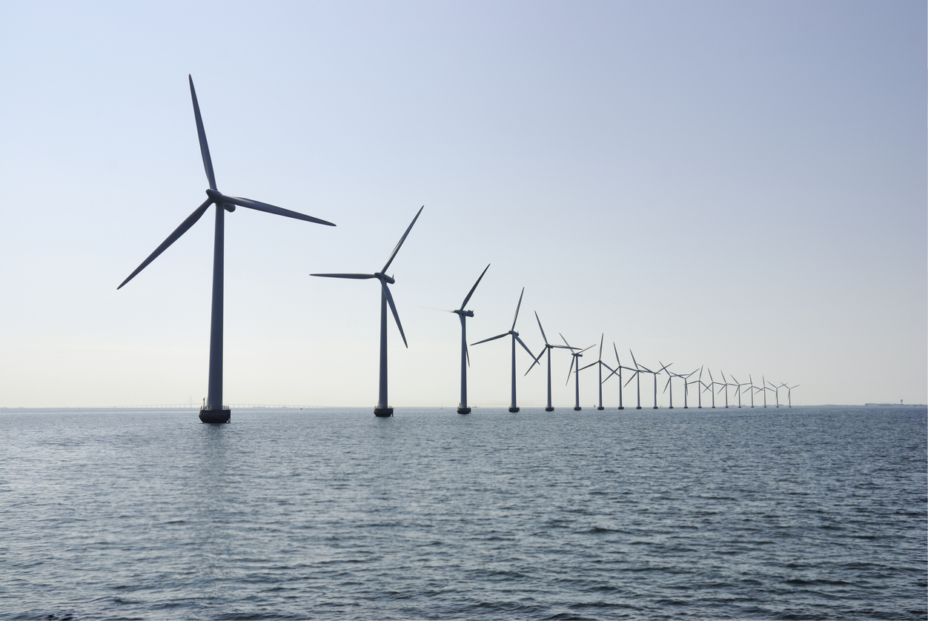
developing cost models for capital expenditures of offshore wind parks R.C Martens

Slide 2
Agenda
Who am I?
Introduction
Cost modelling approach
Choosing the right type of cost model
High level offshore wind cost model
Detailed offshore wind cost models
Developing and maintaining a cost database
Q&A
1/19
Notes:
Let me take you through the agenda.
First, I will give you a brief introduction about myself. Then, I will introduce the subject of developing cost models for offshore wind parks. Subsequently, I will talk about a generic cost modelling approach and about the importance of choosing the right type of cost model. After that, I will talk about a high-level offshore wind cost model, developed by Cost Engineering. Then, we will take a look at some detailed cost models, also developed by Cost Engineering. Lastly, we will talk about how to develop and maintain a cost database, once the cost models are in place.
And finally, we will end by a Q&A session. Please keep your questions till the end of the presentation.

Slide 3
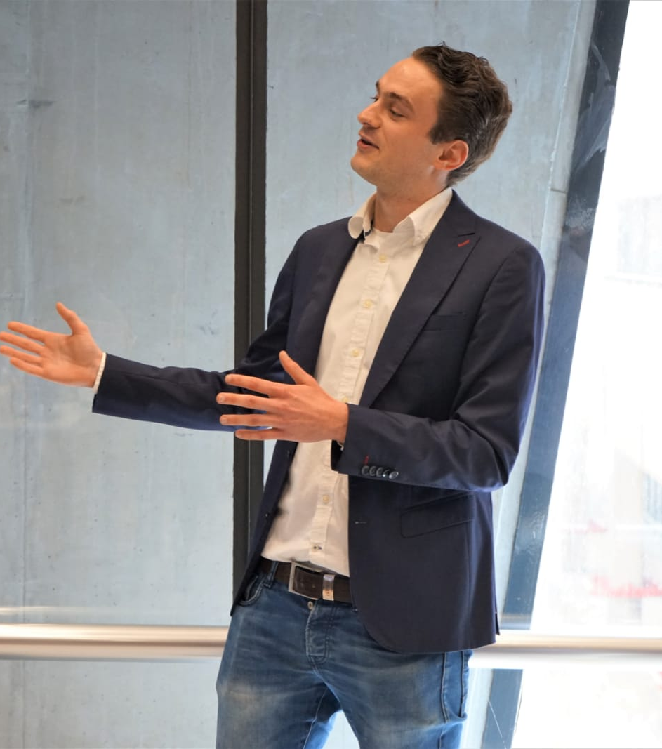
Speaker
Roland Martens
MSc, Offshore Engineering, TU Delft
BSc, Civil Engineering, TU Delft
Started my career at Cost Engineering Consultancy in December 2020
Passionate about renewable energy projects
Have been involved in the development of offshore wind cost models
Love travelling abroad and doing sports such as running, cycling and skiing
2/19
Notes:
Let me start by introducing myself.
My name is Roland Martens, I am 26 years old and I graduated in a Masters in Offshore Engineering at the TU Delft.
I did a Bachelors in Civil Engineering. Ever since I started studying I have been interested and passionate about the financial aspect within engineering. That is why I decided to start my career at Cost Engineering Consultancy in December 2020. I am passionate about renewable energy projects and have been involved in the development of offshore wind cost models.
In my spare time, I love to see the world by travelling abroad and I like doing sport such as running, cycling and skiing.

Slide 4
Introduction
Importance of sustainability and renewable energy
Installation offshore wind parks has increased
Technological developments:
Turbine capacity
Turbine diameter
Turbine height
3/19
Notes:
As all of you know, sustainability and renewable energy have become extremely important in the society of today.
Since the Paris Agreement was signed in 2016, more and more countries feel the urge to invest more in renewable energy sources. To stop climate change, we need to lower the greenhouse gases. For this to happen, we need to invest in renewable energy sources.
I’m happy to tell you this is happening! (CLICK) As you can see in the Figure on the right, the installation of offshore wind parks has significantly increased in the last decade.
(CLICK) Technological developments such as the increase in turbine capacity, turbine diameter and turbine height have led to larger wind farms being installed with more wind farm capacity.
In the upcoming years, more steady growth in the installation of offshore wind parks is expected, because as you can see (CLICK), we are only at the beginning.

Slide 5
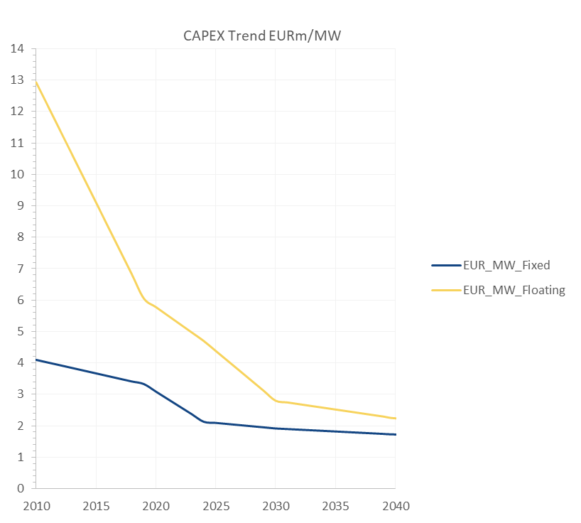
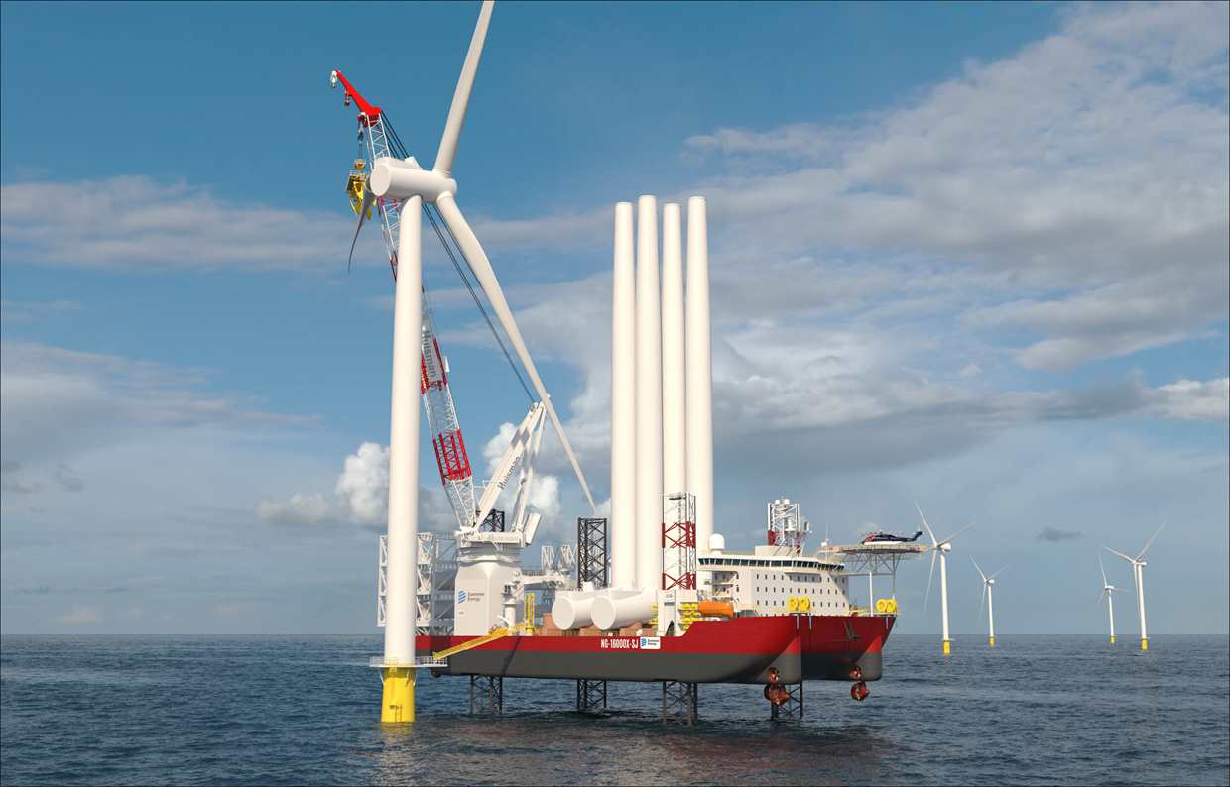
Introduction
Technological developments have led to larger sizes and heavier parts of offshore wind turbines
Leading to higher material costs
Leading to more complex installation
Trend:
Lowering capital expenditures per installed MW over the last decade
Estimating offshore wind parks
4/19
Notes:
These technological developments have led to larger sizes and heavier parts of offshore wind turbines. For example, tower sizes and rotor blades have increased in size. Generally speaking, this leads to higher material costs, since more material is needed. In addition, you may expect more complex installation, since heavier parts need to be installed during installation.
The funny thing is, however, that these larger material volumes and more complex installations have not led to higher capital expenditures. (CLICK). In fact, the trend we see over the last decade is that the capital expenditures per installed MW have dropped. If you look at the graph on the slide, we can see significant dropping of the average capital expenditures per mw price. This means that due to the large market growth in the offshore wind industry, costs are dropping. More know how and more suppliers, in the end lead to lower costs.
So, what can we do with this information about the average capital expenditures of offshore wind parks?
We can make cost models to estimate the costs of offshore wind parks, which is what I am going to talk to you about the rest of this presentation.

Slide 6
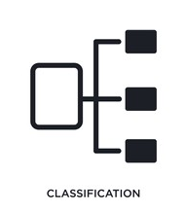
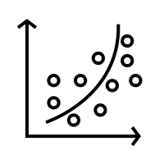
Cost modelling approach
Cost data
Classification cost data
Determine cost variables
Cost modelling
5/19
Notes:
So, how do we develop a cost model for an offshore wind park?
To be able to make a cost model for offshore wind parks, it is possible to make use of the cost modelling approach. I will guide you through the steps of such an estimating approach, specifically for the offshore wind park.
The first, and certainly the most important step, is to gather cost data for the cost modelling. Without cost data, it is not possible to come to an early phase estimate. In this case, we are talking about the cost data for the offshore wind parks.
The second step, is to classify the cost data you have, in this case of an offshore wind park. This means splitting up the cost data in groups such that we get a breakdown of costs. For an offshore wind park, these elements for instance include the wind turbines, foundations, cables and substations.
Once the classification of cost data has been completed, we can start to zoom in. Per element, there are certain key cost drivers. These make up the cost variables for each sub-element. For example, the turbine capacity is the main cost driver for the wind turbine itself.
When the most important cost variables have been defined per sub-element and we have the cost data, we have the information to make cost models. Regression analysis is the most logical analysis to do.

Slide 7
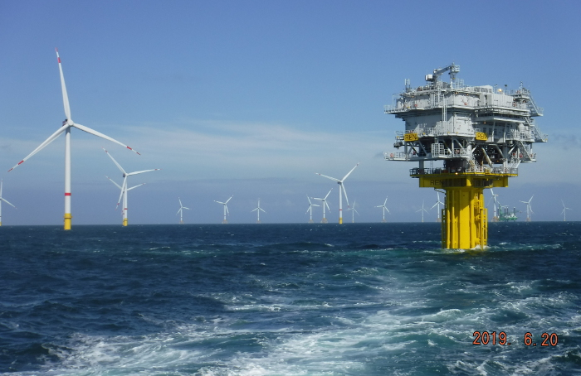
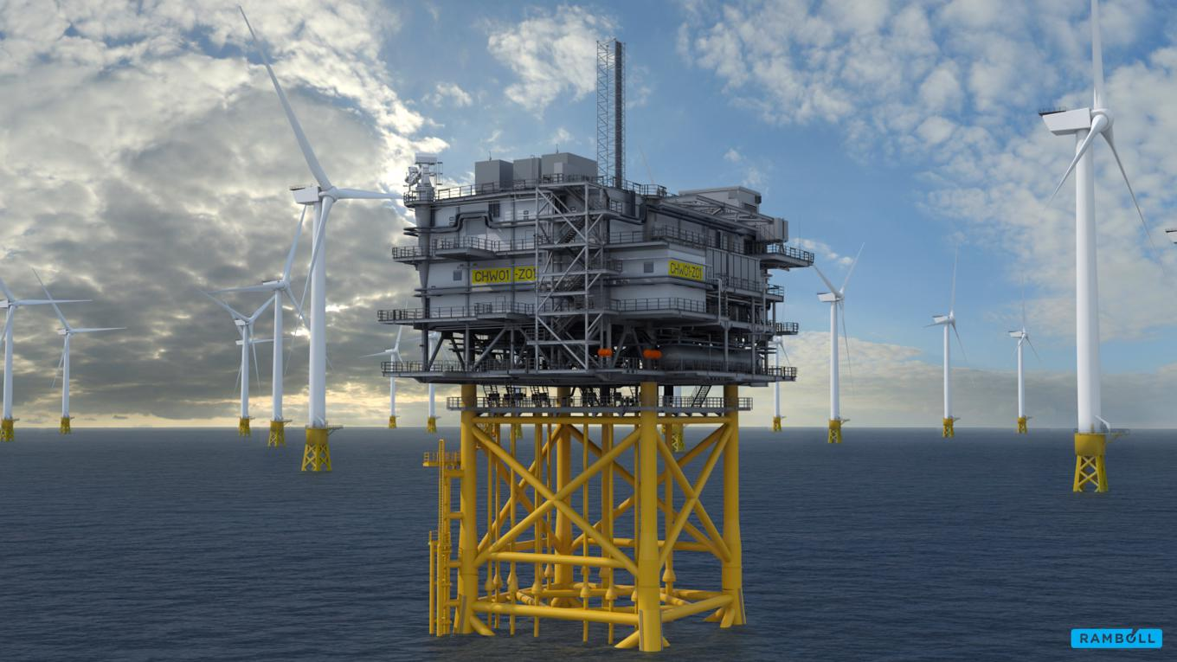
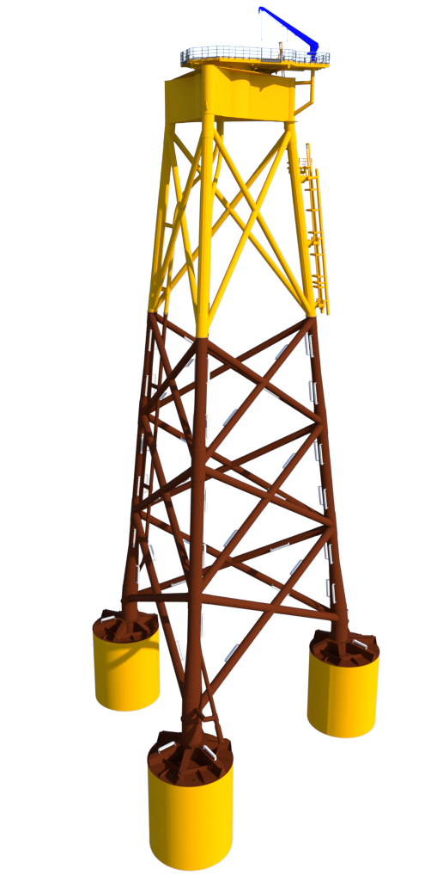
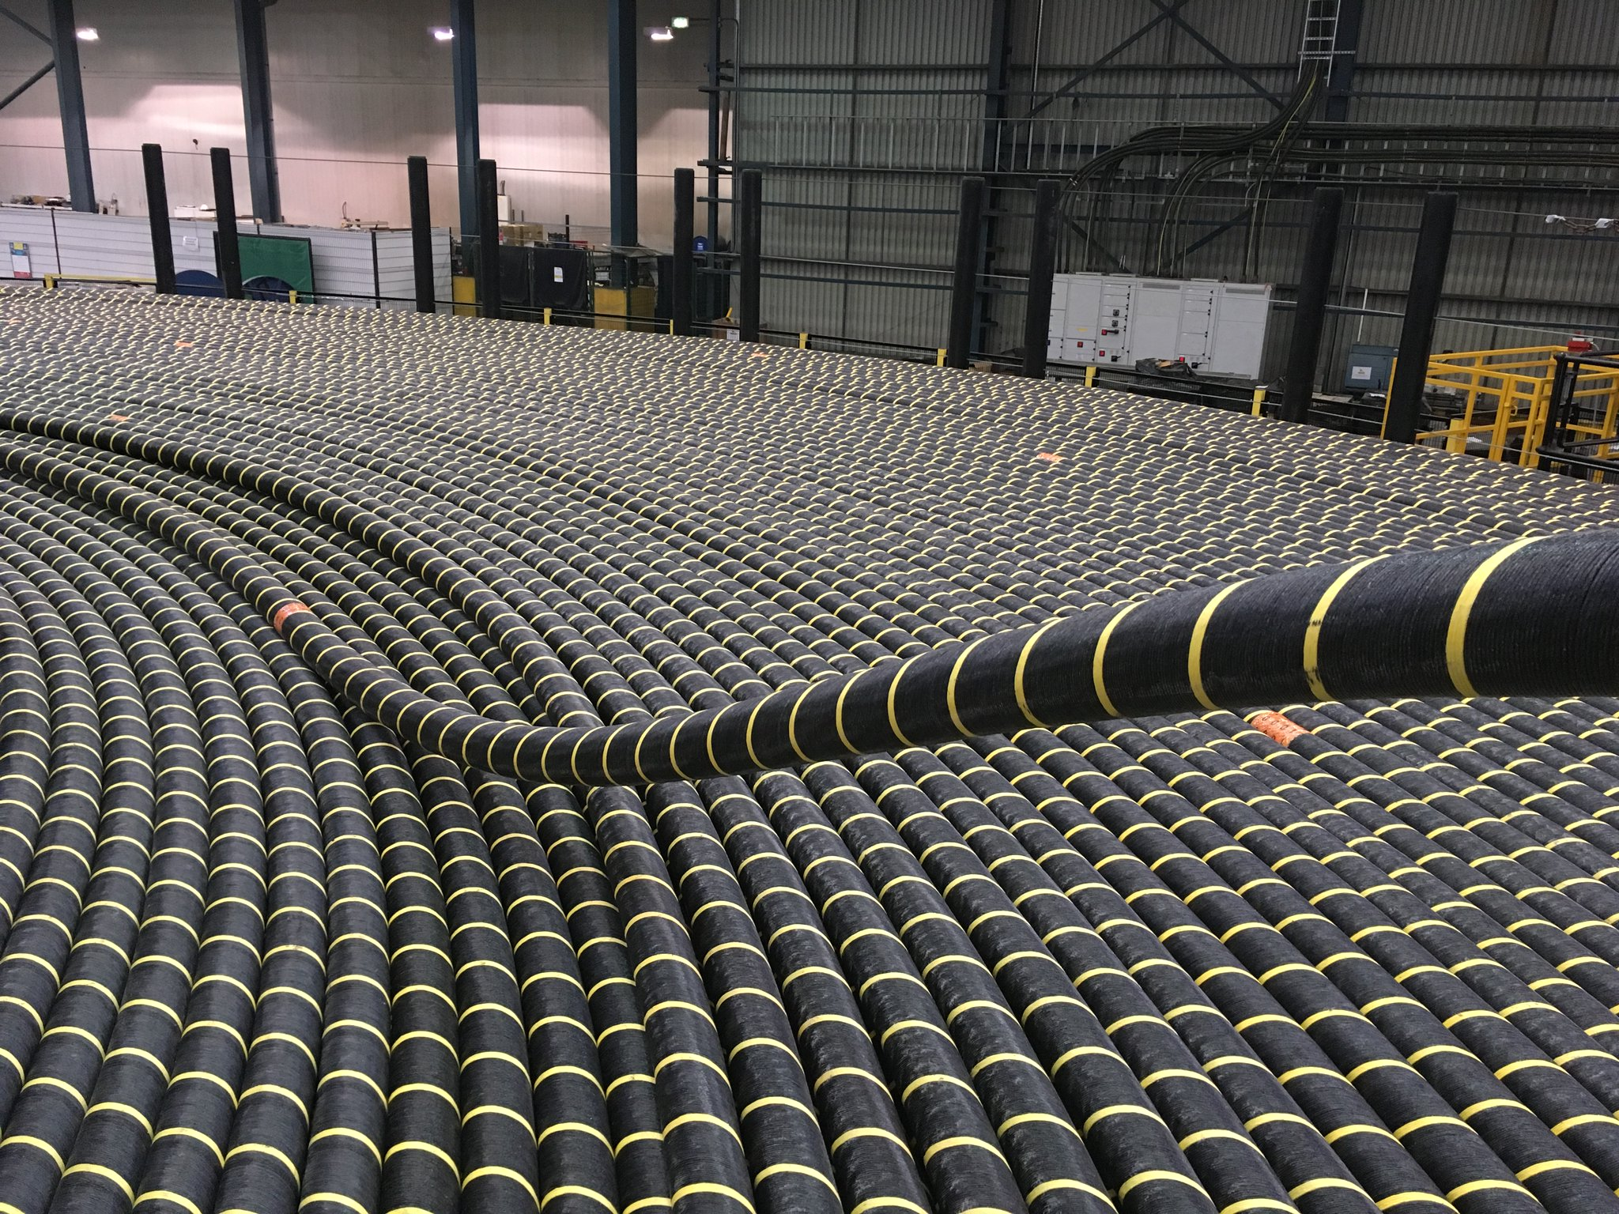
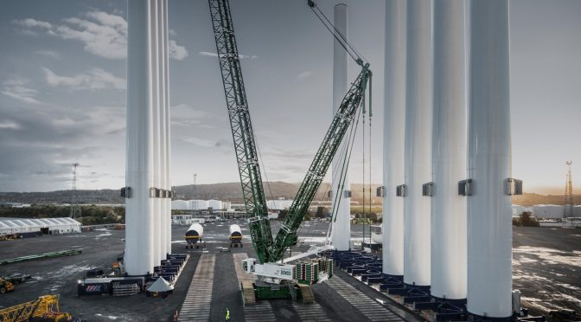
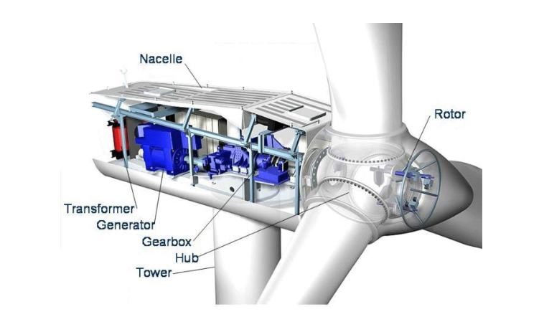
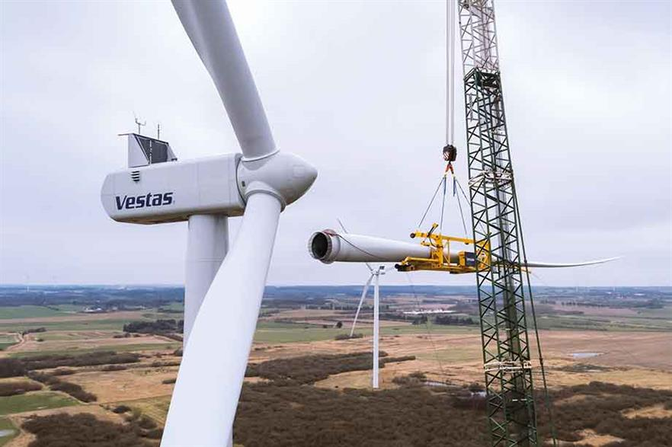
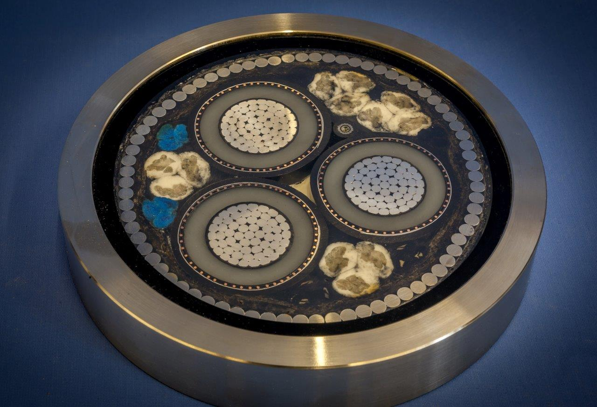
Choosing the right type of cost model
Objects – High level estimate
Information available
Composites
Bill of Quantities
Unit Rates & Details – Detailed estimate
6/19
Notes:
When developing cost models, there are different types of cost models we can develop. This all depends on the information that is available to you. Generally speaking, we can develop a high-level estimate, or a detailed estimate.
In our inhouse software Cleopatra, there is a sub-division of different levels. A high level estimate corresponds to an object level, and a detailed estimate corresponds to a unit rate. The levels in Cleopatra link together to form hierarchical assemblies. Choosing the right level you want to use for the estimate of your wind park, depends on the information you have available about the wind park. Thus, it depends on the stage of the project.
For example, in the beginning phase, you may only have the information available about the total capacity of the total wind farm, but no specifics like the length of the cables etc. In that case, we can use the objects cost model (CLICK). The object cost model is the highest-level estimation, meaning it has a relatively large range of uncertainty.
At a later stage in the project, it may be the case that more information is available. For example, you may have information about the type of wind turbine, the type of cable, the number of km cables and the amount of labour hours needed. Using this information, it is possible to come to a more detailed cost estimation, for instance by using the Unit Rates (CLICK). The Unit Rates cost model is a more detailed cost estimation of the costs. Therefore, it is also more accurate.

Slide 8
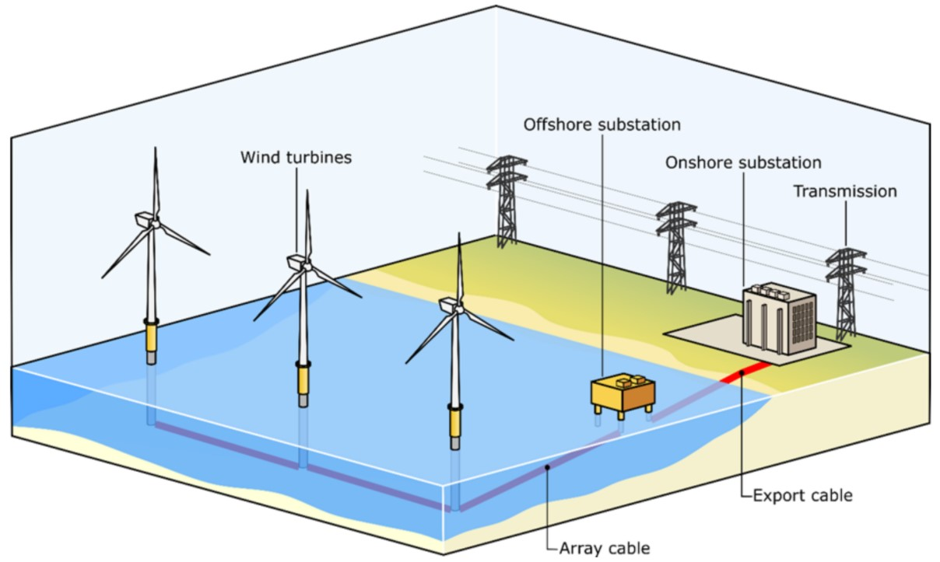
High level offshore wind farm cost model (Object)
7/19
Notes:
To be able to estimate the costs of an offshore wind park, we must understand the components that make up an offshore wind park.
The infrastructure that is needed to provide electricity from the offshore wind park to the end-user can be split up into: wind turbines, cables and substations (see Figure 1).
The wind turbine generally consists of a rotor which is connected to a generator in the nacelle to produce the electricity. The generated electricity is then transported from the wind turbine to an offshore substation by means of array cables. At the offshore substation, the electricity is transformed and then transported to an onshore substation through the array cables.

Slide 9
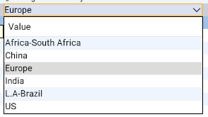
High level offshore wind farm cost model (Object)
8/19
Notes:
Let’s take a look at the high-level offshore wind farm cost model in Cleopatra. This is an Object cost model. Such a model would be used in the beginning phase of a project, in the Front-End-Loading phase.
For this cost model, you can give the following input parameters in the cost model :
Number of turbines
Capacity per turbine
Foundation type, which is either Fixed or Floating.
Region (CLICK), which is either Africa, China, Europe, India, Latin America, or the U.S.
Lastly, it is also possible to choose which parts of the wind farm to include in the cost estimation.

Slide 10
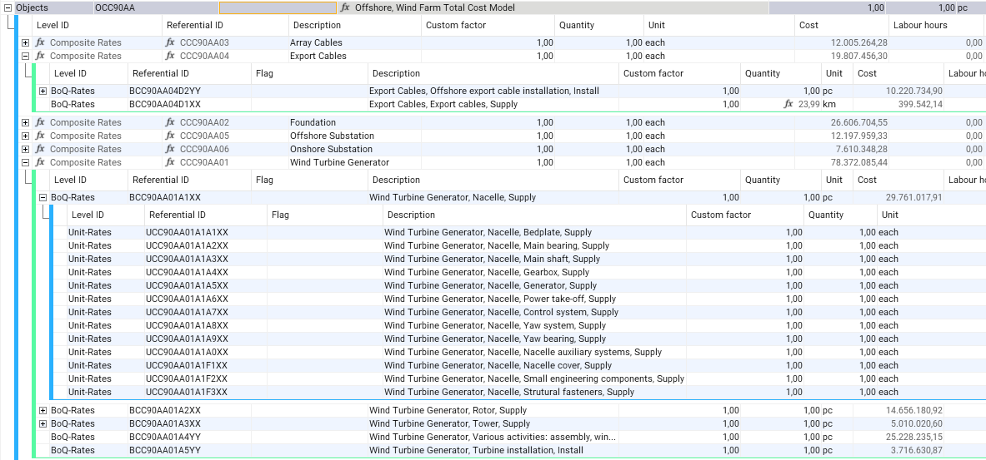
High level offshore wind farm cost model (Object)
9/19
Notes:
Once these input parameters have been defined, the cost model calculates the costs. The calculation is based on a breakdown of percentages and a Capex/MW price. The Capex/MW price is based on the data of the most recent year, indexed to the year that the offshore wind park will be installed.
As you can see, the Objects cost model is divided up into array cables, export cables, foundation, offshore substation, onshore substation and wind turbine generator. These are the composite rates in the cost model.
For the wind turbine generator, we can also see the BoQ-rates, which contain a further breakdown of the costs. For example, the wind turbine generator consists of the nacelle, rotor and tower.

Slide 11
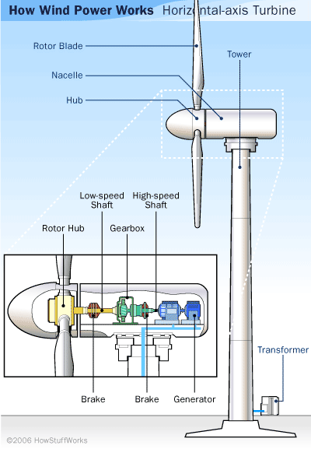
Detailed cost model - Wind Turbine Generator
Wind Turbine Generator costs:
Tower, Rotor assembly, Nacelle
2. Determined cost model variables:
Turbine capacity (MW)
Location
3. Calculated specifications:
Volume and dimensions nacelle
Weight of nacelle (t)
Rotor diameter (m)
Tower weight (t)
Regression
10/19

Slide 12
Regression model - Rotor costs
Fit the cost data with expected cost variables:
Rotor diameter
Rotor weight
Swept area
Choose the model with the best approximation (highest R² value)
Rotor diameter
11/19

Slide 13
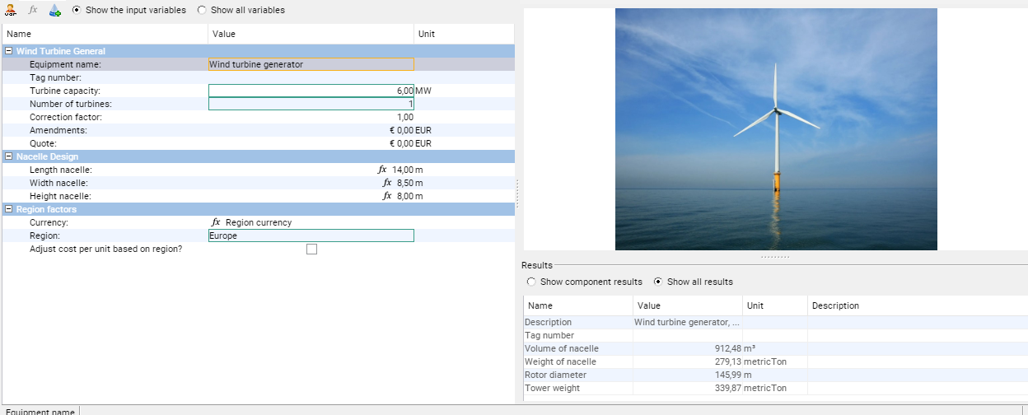
Cleopatra cost model - Wind Turbine Generator
12/19

Slide 14
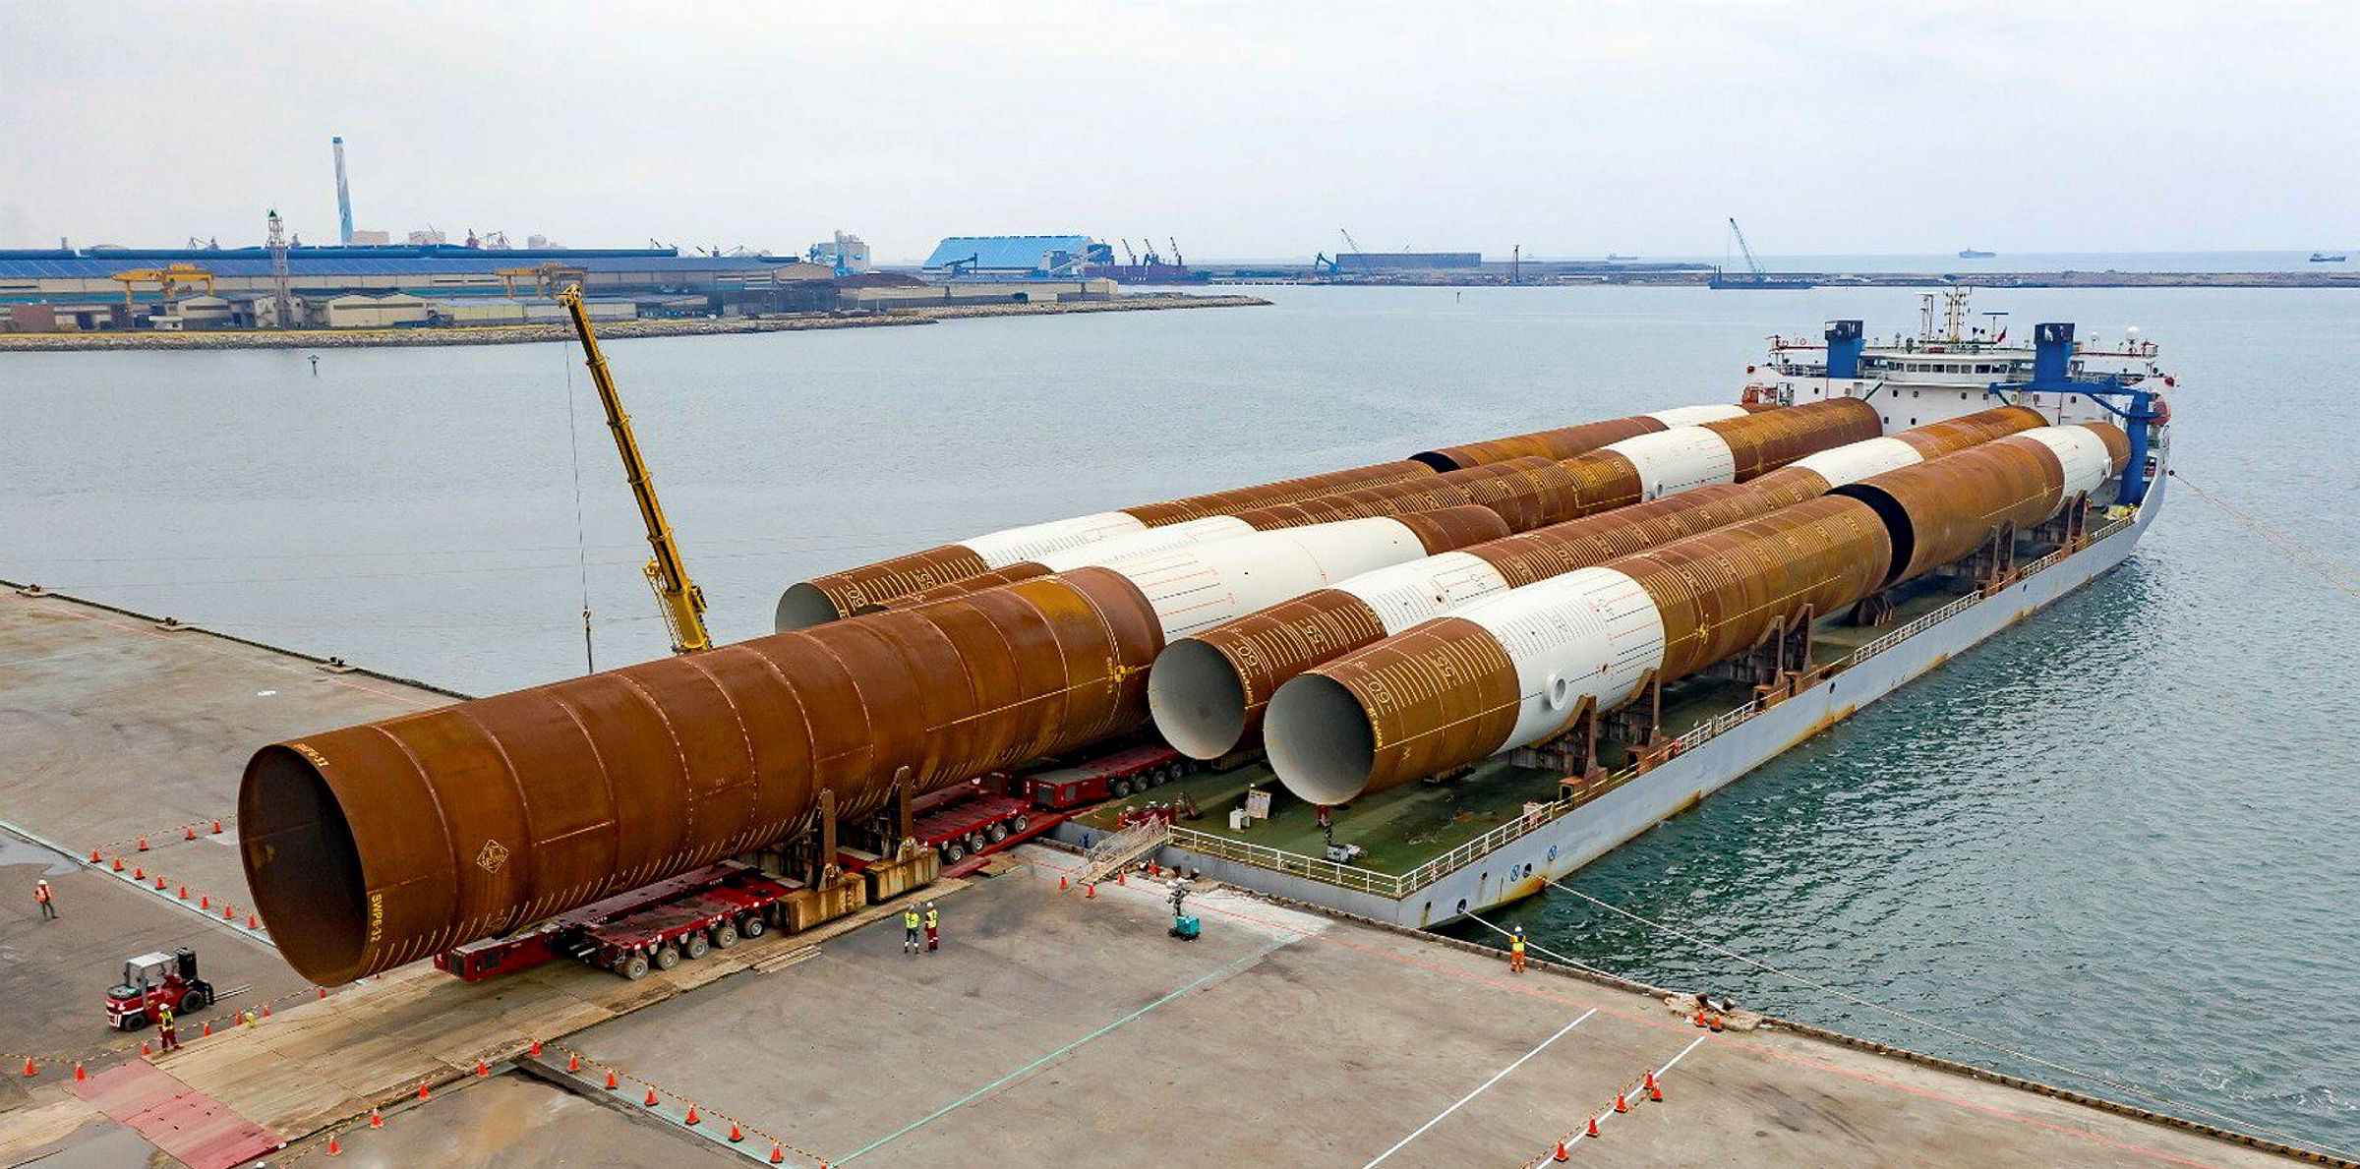
Detailed cost model - Monopile
Monopile costs
Determined cost model variables :
Diameter (m)
Water depth (m)
Calculated specifications:
Length (m)
Surface area steel (m²)
Weight of monopile (t)
Regression
13/19

Slide 15
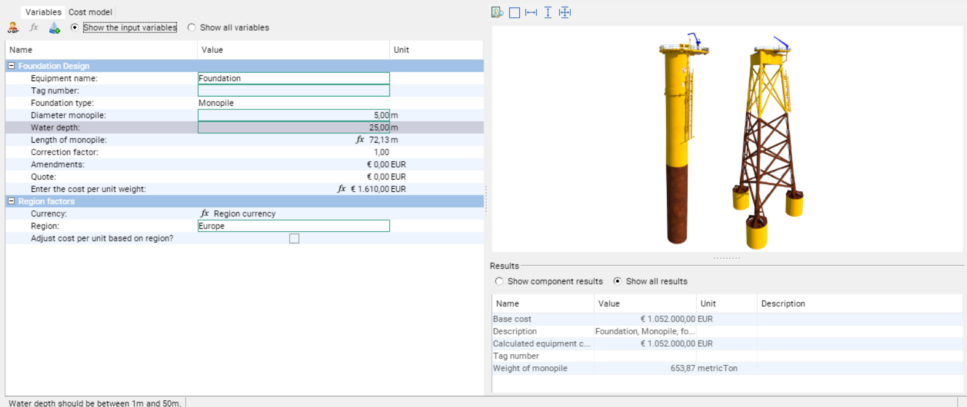
Cleopatra cost model - Monopile
14/19

Slide 16
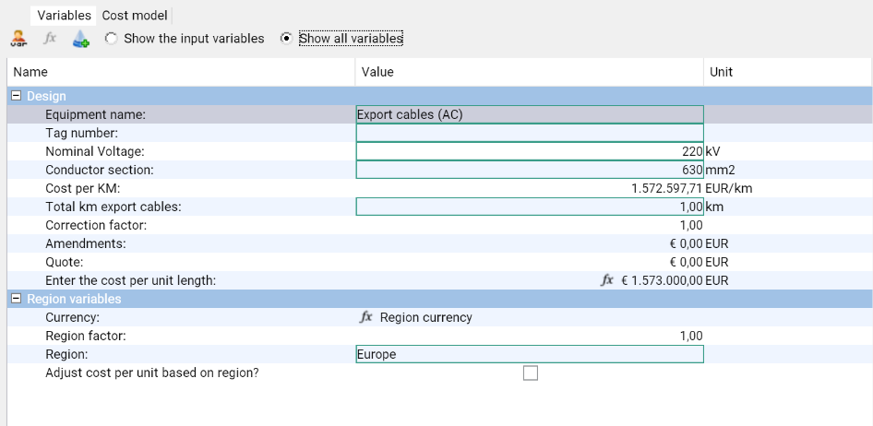
Detailed cost model - Array Cables/Export Cables Model
Array Cables/Export cables costs
Determined cost model variables
Nominal Voltage (kV)
Conductor section (mm²)
Total km of cables
Cost/km price based on multi-variate regression
Nominal Voltage (kV)
Conductor section (mm²)
15/19

Slide 17
Offshore Substation (HVAC) Model
Offshore substation costs:
Jacket structure
Topside structure
Determined cost model variables :
Windfarm capacity (MW)
Calculated specifications:
Foundation weight (t)
Topside weight (t)
Total weight of structure (t)
Regression
16/19

Slide 18
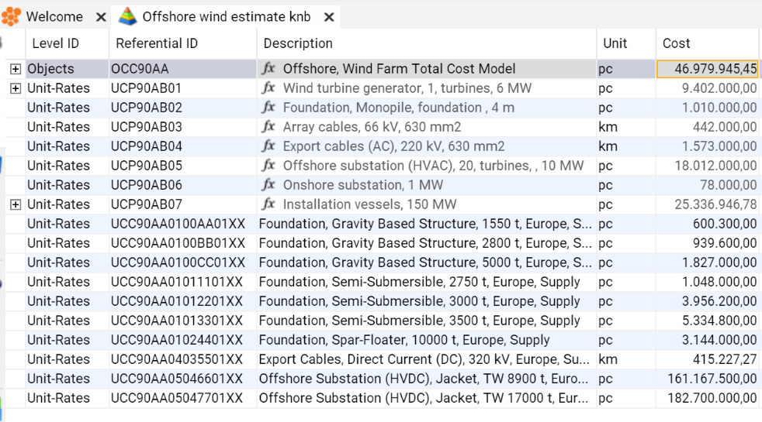
Maintaining a cost database
Using one standardized cost database is recommended
Central place to store and maintain cost information
Use of hierarchical breakdown structure
Indexation of the cost models
Standard cost reports
17/19
Notes:
Once a cost model for an offshore wind park has been produced, it is important to keep the structure of the model in a standard format.
A good solution to keep the cost data in a standard format, is to use a cost database. The cost database can function as a central place to store and maintain all the cost information. Hierarchical breakdown structures can be used to have a structured overview of all the components in the cost database. To keep the prices up to date throughout time, we can for instance use indexation tables to index the costs to the correct moment in time. Next to this, it is also possible to use the cost database for standard cost reports over time. Using a cost database therefore is of high added value to successfully estimate the capital expenditures of offshore wind parks.

Slide 19
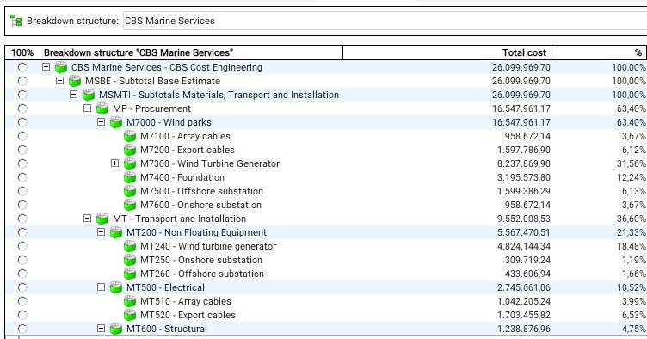
Cost reports using breakdown structures
18/19
Notes:
Standard cost reports can for instance be made by assigning cost components to a breakdown structure in Cleopatra. For example, in this breakdown structure, we can see the sub-division of the infrastructure of the wind park. We can see the cables, the wind turbine generator, the foundation and the substation. It also shows us the percentage of the total costs of the breakdown keys.

Slide 20
Q & A
DO YOU WANT TO KNOW MORE?
Visit our booth on the conference!
Schedule a demo on our website www.costmanagement.eu
19/19

Slide 21
Back-up slides
Offshore Wind Parks

Slide 22
Class 5 Offshore Wind Estimate
Georegion | Multiplier
Europe | 1
Asia | 1,5
China | 0,9
North America | 1,3
South America | 1,3
Australia | 1,5
1. Cost model input:
Amount of turbines
Average MW per turbine
Region: Europe/APAC/China/Americas
Foundation: Fixed/Floating
Offshore start year
2. Determine:
Region Factor
CAPEX M€/MW

Slide 23
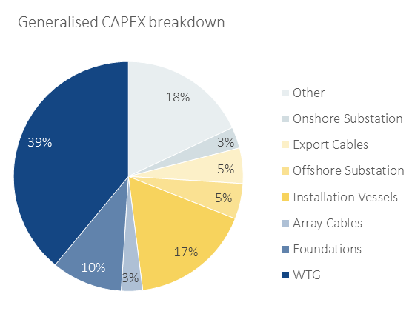
Class 5 Offshore Wind Estimate
3. Calculate:
Total costs = M€/MW * amount of MW * Region Factor
4. Calculate:
Detailed Cost Breakdown
Supply and Install
Region factor, M€/MW
Detailed Cost Breakdown

Slide 24
Parametric Model – Installation
Installation costs of the following components are estimated:
Wind Turbine Generator
Wind Turbine Foundation
Array cables
Export cables
Offshore substation

Slide 25
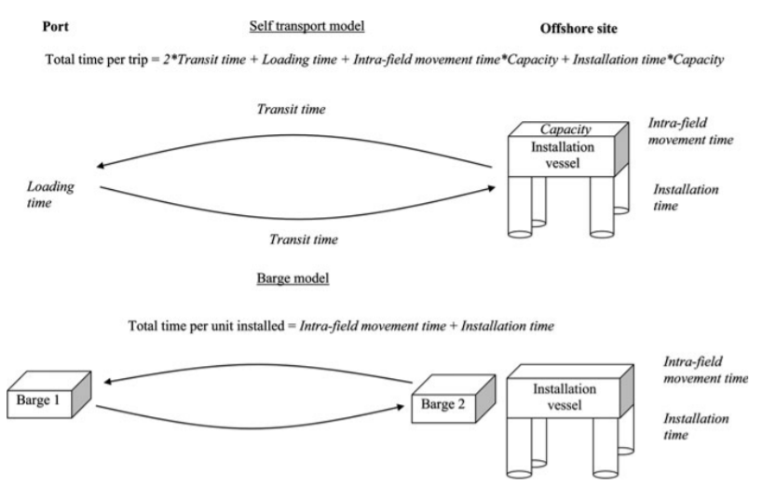
Parametric Model – Installation
Two types of installation models for foundation installation:
Barge: barge will transport the monopiles and TPs from staging area to site, installation vessel will perform the activities
Self-transport model: installation vessel will pick-up monopiles and TPs, return to site, begin operations

Slide 26
Parametric Model – Installation
Inputs for installation model:
General
Farm capacity (MW)
Turbine capacity (MW)
Number of substations (-)
Vessels for WTG / Foundation
Vessel type for WTG / Foundation (Crane Vessel or SSCV/DCV), including lift capacity
Number of vessels for WTG / Foundation (-)
Distance to port for WTG / Foundation (nm)
Weather-adjustment factors for WTG / Foundation (%)
Vessels for Substation
Vessel type for Substation (Heavy Lift < 1000 t or > 1000 t)
Export cables
Export cable length (km)

Slide 27
Parametric Model – Installation
Based on the input variables, suggested values are calculated:
Vessel type for WTG / Foundation
Main installation vessel day-rate (EUR/day)
Total spread day-rate (EUR/day)
Load time per trip (h)
Vessel speed (knots)
Installation time per unit (h)
Load time per unit (h)
Inner array move time per unit (h)

Slide 28
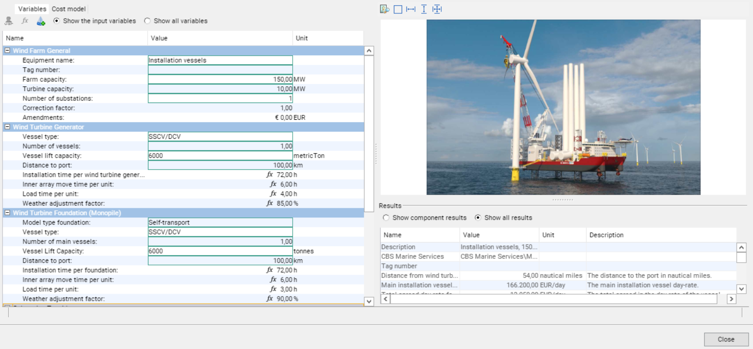
Parametric Model Cleopatra – Installation

