Slide 1
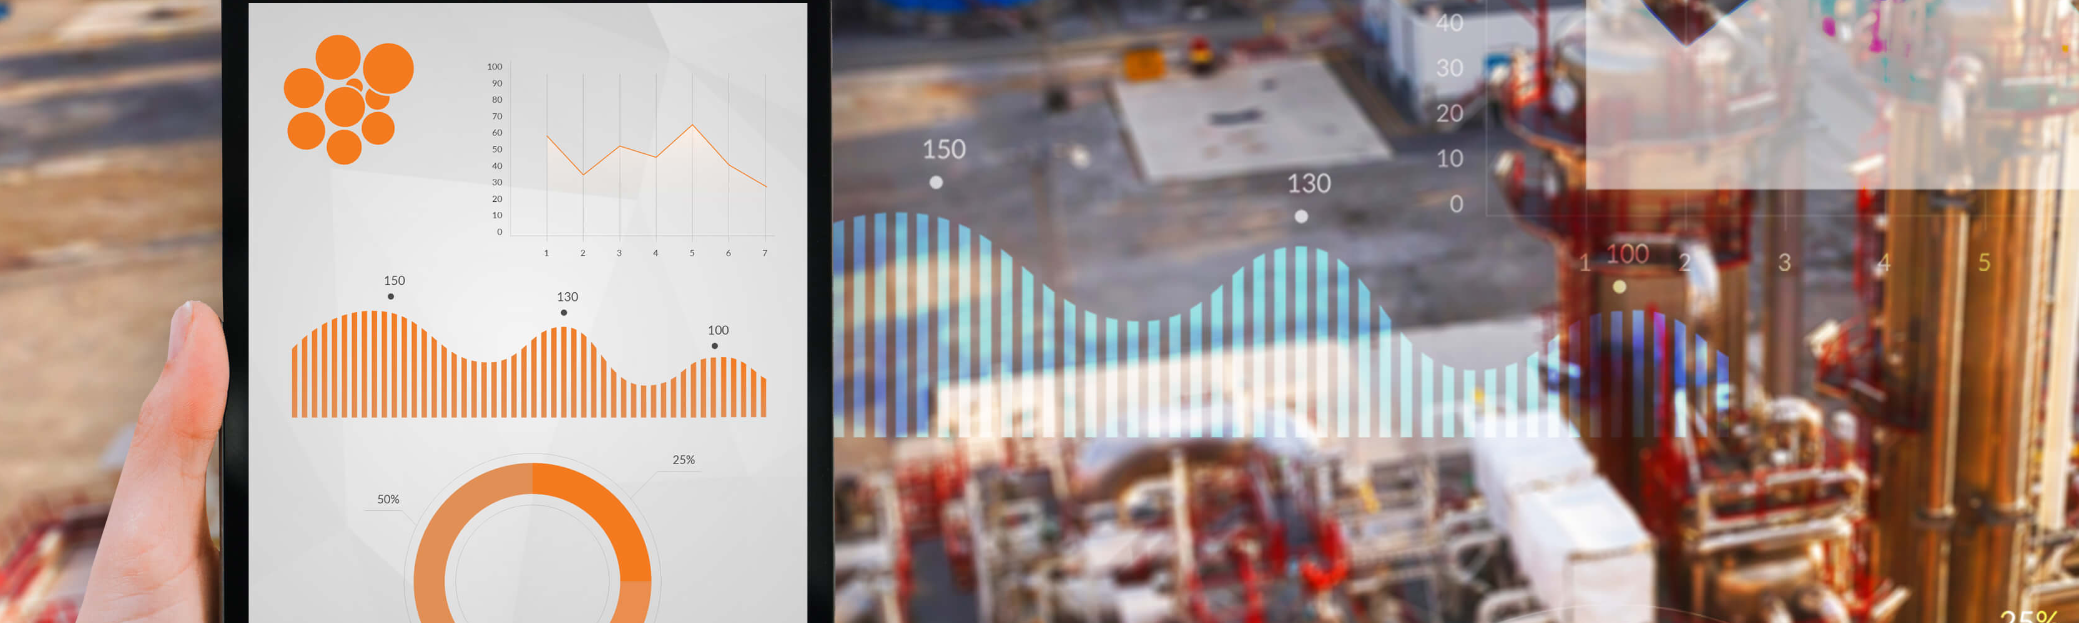


Successful software implementations
A structured approach to implementing digital cost engineering solutions
Sharon Bosch

Slide 2


Agenda
Introduction
Implementation of digital solutions
  Reasons
  Challenges
Structured implementation approach
  Front-End Loading (FEL)
  Steps explained
Q&A

Slide 3
Speaker
Sharon Bosch
Software Implementation Consultant
Cost Engineering Consultancy
Rotterdam / Zwijndrecht
MSc. Chemical Engineering, TU Delft
Cleopatra Implementations for multinational companies in different industries
Experienced in PRINCE2 and Scrum processes
Notes:
New picture here

Slide 4





About Cost Engineering Consultancy
For 25 years, empowering organizations
to improve their project and TA performance
Cleopatra Enterprise
Cost Database (CESK)
Consultancy Services
Cost Engineering Academy

Slide 5
























Some of our clients
Bulk storage
Construction industry
EPC(M)
Food and Nutrition
Infrastructure
Offshore
Oil & Gas industry
Heavy industry
Pharmaceutical industry
Petro-/chemical industry
Power industry
Mining & Minerals
Notes:
This is just a grasp of the clients we are serving. We serve a wide variety of industries and we have been doing this since 1996. We basically state that we can support any industry that performs complex technical projects. These include Oil&Gas, pharma, mining, energy, Offshore & Marine and infrastructure.
Some mentionable companies here would be Siemens Gamesa, Boskalis and Heerema, who are within either the renewable energy / offshore business.
Check logos

Slide 6

How to improve the Project Performance?
Scoping & estimating
Data analytics
WORK PACK MANAGEMENT
I
N
T
C
C
E
E
P
J
T
O
I
R
O
P
N
cost management
BIM
P
N
R
O
O
I
J
T
E
U
C
C
T
E
X
E
Execution management
SCHEDULING
TENDERING & contracting

Slide 7
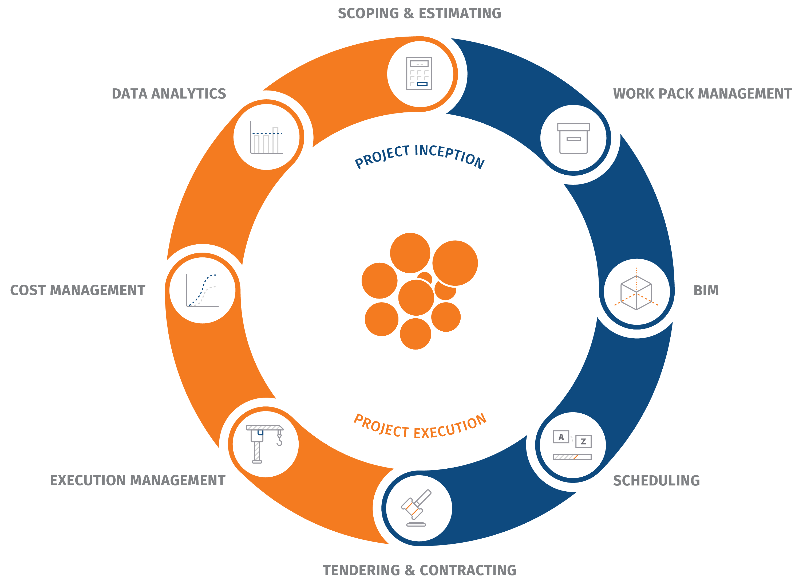
How to improve the Project Performance?

Slide 8

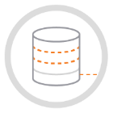


How to improve the Project Performance?
Cleopatra Enterprise
CESK Data
Academy
Consultancy

Slide 9


Implementation projects
Reasons & Challenges
Digital solutions

Slide 10
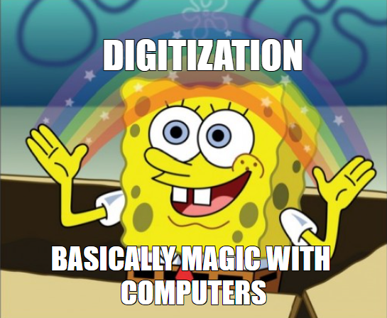
Digitalization
“The amalgamation of digital technologies into our day-to-day work.”
Notes:
Emelgameetion.

Slide 11

Why digitalize?
Improve total cost management processes:
Quick exchange of information on worldwide scale
Consistency, so quality improvement
Save time
Data analytics
Capital project costs decrease up to 45% [1].
[1] McKinsey: S. Blackburn, J. Galvin, L. LaBerge, and E. Williams. Strategy for a digital world, October 8, 2021.
Notes:
Less human errors -> consistency

Slide 12

Common challenges
No standardised work process
Notes:
Every individual creating own estimates; other formats etc. hard to implement a software then
[Cargill] Client had nog helemaal geen structuren. Vergelijken helemaal niet nodig. Geen data formaat. ; where overspending? Underrunning? No feedback loop possibe.

Slide 13
Common challenges
No standardised work process
No harmonisation and integration
Notes:
“Throw over the fence” or “wall” saying & sequential way of working
Give example client; Cost estimate -> Cost management; they didn’t use the input at all; did a lot of manual work. What are they even doing with it?
[DSM] Client mistakes in actuals; planners gebruiken eigen WBS wat niet aligned.
-> need to come up with a work process that is standard, harmonised and used everywhere

Slide 14
Common challenges
No standardised work process
No harmonisation and integration
Lack of time resources
Notes:
Onderschatten van tijd die het kost om alles echt goed te implementeren
Commitment naast hun day-to-day work. Management moet dit steunen.
Ze moeten uren schrijven op projecten.

Slide 15
Common challenges
No standardised work process
No harmonisation and integration
Lack of time resources
Integration within current IT architecture
Notes:
[Fluor] Data change in een de systemen; alle versies direct niet meer aligned.

Slide 16
Common challenges
No standardised work process
No harmonisation and integration
Lack of time resources
Integration within current IT architecture
Security regulations

Slide 17
Common challenges
No standardised work process
No harmonisation and integration
Lack of time resources
Integration within current IT architecture
Security regulations
Resistance to change
Notes:
Resourcs / management

Slide 18


The measure of intelligence is the ability to change.
- Albert Einstein

Slide 19

Reasons for resistance
Afraid of the unknown
No clear need for change
Perceived loss of power/control
Lack of understanding
No trust in management
Previous negative experience
Afraid for more work
Notes:
Comfort zone; not used to software
Learning difficult
Just a MT info; don’t see benefits themselves
Driving in a self-driven car for the first time
Not clearly explained; no clear goals given; not involved in decisions
Maybe new person? No idea
Other useless software
Afraid for more work next to their already busy job

Slide 20
Structured approach
Implementation of digital solutions
Project environment
Notes:
Not sure about the titles here

Slide 21

Implementation Approach
Cleopatra Enterprise
Other software tools

Slide 22

Cost Engineering approach
(Custom) Showcase
Needs Assessment Workshop
ImplementationPlan
Implementationwith specification workshops
Pilot projects
Go-Live
Approval
Approval
Approval
Verification
Acceptance
FEL 1
Opportunity identification
FEL 2
Conceptual engineering
FEL 3
Basic engineering
Execution
Pre-operation
Operation

Slide 23
Cost Engineering approach
(Custom) Showcase
Needs Assessment Workshop
ImplementationPlan
Implementationwith specification workshops
Pilot projects
Go-Live
Approval
Approval
Approval
Verification
Acceptance
FEL 1
Opportunity identification
FEL 2
Conceptual engineering
FEL 3
Basic engineering
Execution
Pre-operation
Operation

Slide 24

1. Exploration for new software tool
Identify current issues
Demonstration tool
  Clear, but not too overwhelming
  Customise for recognition own data/methods
  Discuss solutions
Management and end-users involved
Notes:
-> to start already avoiding the challenges:
Take away the doubts
Create an open communication environment

Slide 25
Cost Engineering approach
(Custom) Showcase
Needs Assessment Workshop
ImplementationPlan
Implementationwith specification workshops
Pilot projects
Go-Live
Approval
Approval
Approval
Verification
Acceptance
FEL 1
Opportunity identification
FEL 2
Conceptual engineering
FEL 3
Basic engineering
Execution
Pre-operation
Operation
Notes:
After approval

Slide 26
2. Needs Assessment Workshop
Preparation
Demonstrations
Interviews
Discussions
Notes:
How? Interviews
Client should be prepared. Questionnaires should be filled; they should work on it by then.
They come and sit; tell us.-> They should know what they want.
Examples based on discussion prepared or on the spot.
Work process in diagram.

Slide 27
2. Needs Assessment Workshop
Fully investigate the current problems
Mutual understanding requirements
Define success criteria
Proof of concept
Select the best solutions
Explore IT landscape for a smooth deployment
Discuss potential issues
Buy-in all stakeholders
Give insight in implementation effort/time/cost

Slide 28
Cost Engineering approach
(Custom) Showcase
Needs Assessment Workshop
ImplementationPlan
Implementationwith specification workshops
Pilot projects
Go-Live
Approval
Approval
Approval
Verification
Acceptance
FEL 1
Opportunity identification
FEL 2
Conceptual engineering
FEL 3
Basic engineering
Execution
Pre-operation
Operation
Notes:
After approval

Slide 29

3. Implementation plan
Findings workshop
Detailed out final solution
Work process (diagram)
  Optimized
  Standardized
  Harmonized
Notes:
Use of visualisations, examples, tables, where possible to give a good impression of the solution
For specific steps of the work process the details will be provided by other departments within our
company: each department is specialised in certain parts of the software and its functionalities.
All the steps are mostly explained by tables, diagrams, and figures instead of large amounts of
text in order to be manageable to digest easily by all stakeholders. Within the plan practical
examples based on the client’s data will be added to convince the client of the software solution.

Slide 30
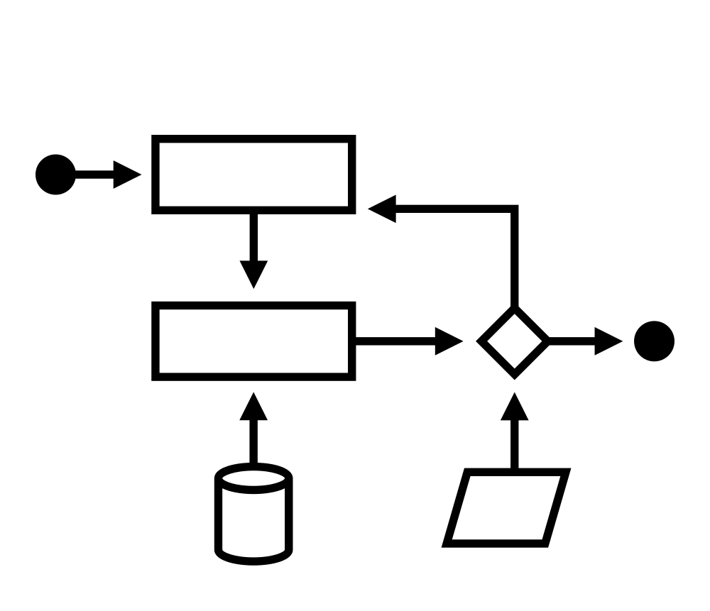
3. Implementation plan
Optimized, standardized harmonized work process
Reductions in variability
Easier training of new users
Reductions in human errors
Have a baseline for future improvement activities
Notes:
Comparable with P&ID (piping and instruments)
The work process will be visualised in a diagram, which should be one clear but
extensive overview in order to be the leading for the implementation.
The work process should be standardised and harmonised for all departments within the client’s organisation to gain its benefits;
reductions in variability,
easier training of new users,
reductions in human errors,
and a have a baseline for future improvement activities

Slide 31




3. Implementation plan
Deliverables
Implementation
Plan
Implementation Schedule
Implementation Quotation
Notes:
Risks + mitigation plans
Detailed description of activities in proposed timeline
Actions and responsibilities of client
High-level with examples

Slide 32
Cost Engineering approach
(Custom) Showcase
Needs Assessment Workshop
ImplementationPlan
Implementationwith specification workshops
Pilot projects
Go-Live
Approval
Approval
Approval
Verification
Acceptance
FEL 1
Opportunity identification
FEL 2
Conceptual engineering
FEL 3
Basic engineering
Execution
Pre-operation
Operation
Notes:
After approval

Slide 33

4. Implementation
IT team
  Deployment
  Training
Core team of key users
  Training
  Specification workshops for steps of the new work process
Notes:
Tool champions; community feeling
Communication plan with PM on client side
Regular pm meetings
Sponsor meeting
Deployment
Training with core users

Slide 34
4. Implementation
Specification workshops
Review data input
Further detailing out
Specification report
Agreements and criteria
Formal approval required
Scope definition
Active involvement of end-users
Notes:
Similar to detail engineering
Certain parts of the software should be further detailed out by our experts, which specifications workshops will be organised to detail out the requirements and software implications.
The specifications details will be captured in a report, which will require formal approval of the client before the related implementation activities will start. In this way, the client will be obliged to be actively involved in the implementation details and has the opportunity to provide feedback.

Slide 35
4. Implementation
Scope & Quality Control
Regular testing periods
Sense of community
Feedback meetings
Compare against goals and success criteria
Make the tool their own
Change management

Slide 36
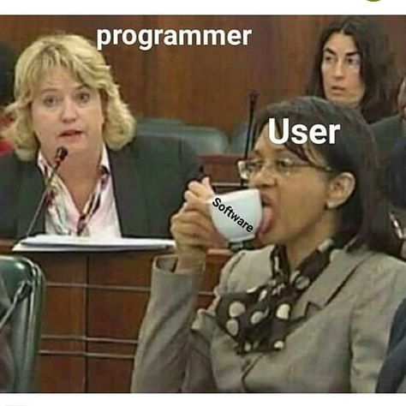
4. Implementation
User guidelines
  Hands-on
  Own data and setup
Train-the-trainer approach

Slide 37
Cost Engineering approach
(Custom) Showcase
Needs Assessment Workshop
ImplementationPlan
Implementationwith specification workshops
Pilot projects
Go-Live
Approval
Approval
Approval
Verification
Acceptance
FEL 1
Opportunity identification
FEL 2
Conceptual engineering
FEL 3
Basic engineering
Execution
Pre-operation
Operation
Notes:
After approval

Slide 38
5. Pilot projects
5. Pilot projects
Smooth guided start
“Real” projects
Complete work process
Learning by doing
User-acceptance tests

Slide 39
Cost Engineering approach
(Custom) Showcase
Needs Assessment Workshop
ImplementationPlan
Implementationwith specification workshops
Pilot projects
Go-Live
Approval
Approval
Approval
Verification
Acceptance
FEL 1
Opportunity identification
FEL 2
Conceptual engineering
FEL 3
Basic engineering
Execution
Pre-operation
Operation
Notes:
After approval

Slide 40
6. Go-Live
Roll-out: Support by management
  Explaining the reasons to implement the new software tool
  Showing its benefits
  Freeing up enough time in the agendas of the new users

Slide 41

6. Go-Live
E-learning
Classroom trainings
Learning by doing
Support by core users

Slide 42

6. Go-Live
After Go-Live support
Long-term partnership approach between client and vendor
Customer success management
Always looking for improvements

Slide 43

Q & A
DO YOU WANT TO KNOW MORE?
Visit the Cleopatra booth
Schedule a demo on www.cleopatraenterprise.com

