Slide 1



Digital work pack management what we can learn from shutdowns and maintenance applying digital work pack management
Bas Druijf

Slide 2

Agenda
Bas Druijf
What is a shutdown?
Today’s challenges
Digital Work Pack Management
  Re-use historical data
  Standardization
  The way forward
Q&A
STO Competence Centre Lead
Cost Consultant
Shutdown, Turnarounds and Outages team lead at Cost Engineering Consultancy and Cleopatra Enterprise.
Has offered consultancy services and software implementations at various clients, such as Neste, Vopak, LyondellBasell, Dow and Cargill.
www.STOcontrol.com

Slide 3





About Cost Engineering Consultancy
For 25 years, empowering organizations
to improve their project and TA performance
Cleopatra Enterprise
Cost Database (CESK)
Consultancy Services
Cost Engineering Academy
www.STOcontrol.com

Slide 4
















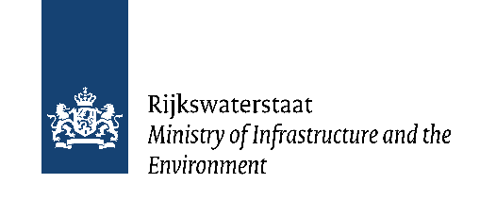







Some of our clients
Bulk storage
Construction industry
EPC(M)
Food and Nutrition
Infrastructure
Offshore
Oil & Gas industry
Heavy industry
Pharmaceutical industry
Petro-/chemical industry
Power industry
Mining & Minerals
Notes:
This is just a grasp of the clients we are serving. We serve a wide variety of industries and we have been doing this since 1996. We basically state that we can support any industry that performs complex technical projects. These include Oil&Gas, pharma, mining, energy, Offshore & Marine and infrastructure.
Some mentionable companies here would be Siemens Gamesa, Boskalis and Heerema, who are within either the renewable energy / offshore business.
Check logos

Slide 5
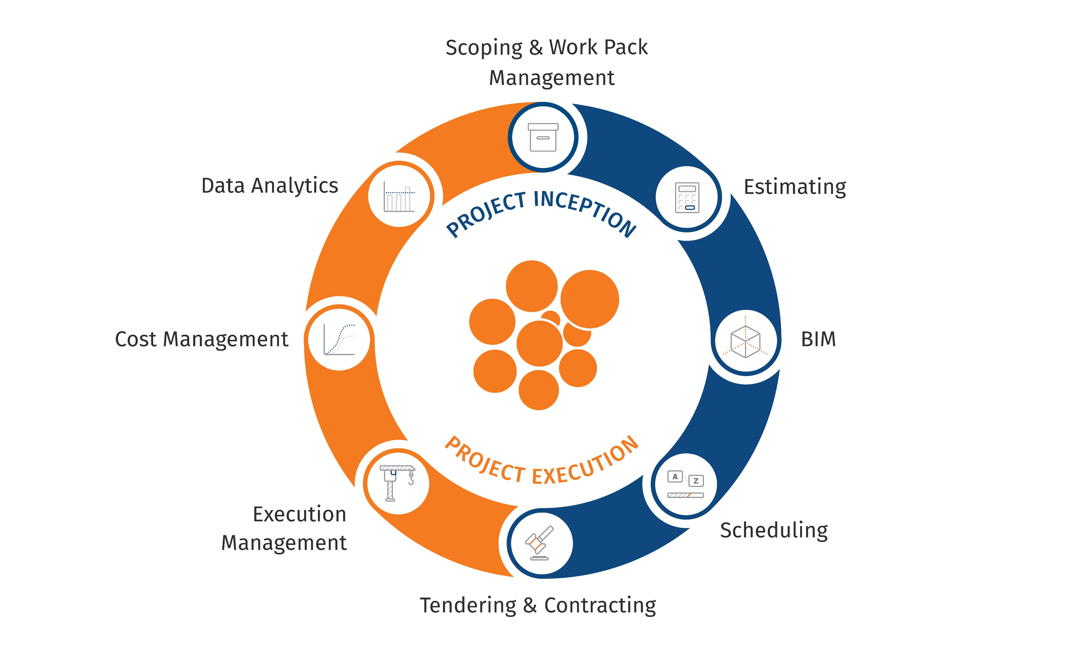
Our vision
www.STOcontrol.com
Notes:
Estimating, Cost Control, Planning, Information Management, Document Control & ERP support.
Key message: All systems used for the Project (excel, ERP, P6, Easy rsk etc) work stand-alone and require manual exchange of files and reconsiliation (inefficient)
Excel, P6 and SAP were the primary tools used
Question:
How did this work for the L13FI platform
Can you tell more about estimating during the project stages?

Slide 6



What is a shutdown?

Slide 7
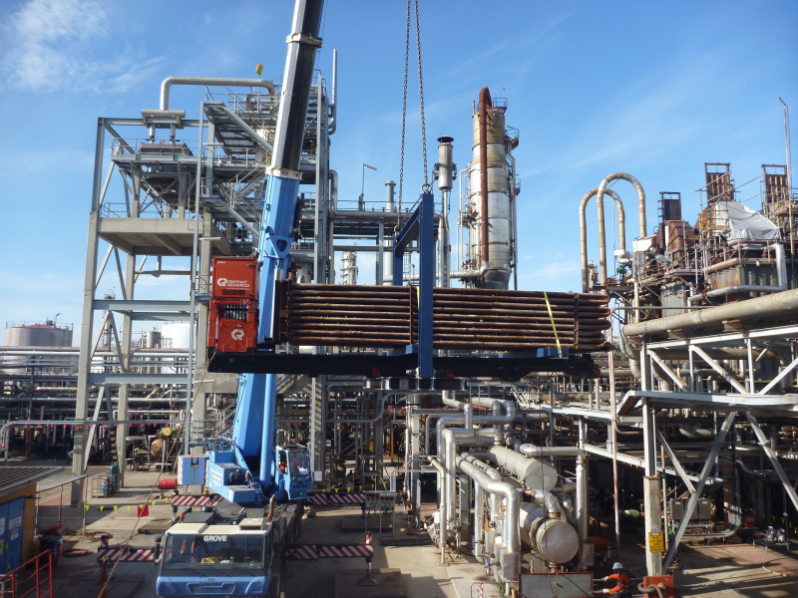
What is a shutdown?
Wikipedia says:
“A shutdown is a scheduled event wherein an entire process unit of an industrial plant is taken offstream for an extended period for revamp and/or renewal.”
“They are the most significant portion of a plant's yearly maintenance budget and can affect the company's bottom line if mismanaged.”
www.STOcontrol.com
Notes:
Elmer introduces the case as being a best practice at shell.
Question
Richard, tell us about this.
Fabrication, pre-commissioning, load-out and seafastening of the Monotower Platform L13-FI-1. The design of the Monotower Platform is based on the existing L09-FA design. Produced gas will be exported by a 12” pipeline to K15-FA-1. A piggyback line will be installed for import of one production chemical (KHI). On the platform an injection skid, comprising of a storage tank and injection pumps, will be installed for injection of a second production chemical (CI)

Slide 8
Shutdowns, Turnarounds and Outages (STOs)
STOs are essential activities in the process industry.
They are all about maintaining a consistent productive capacity.
Major projects that requires sound planning, execution and control.
www.STOcontrol.com

Slide 9
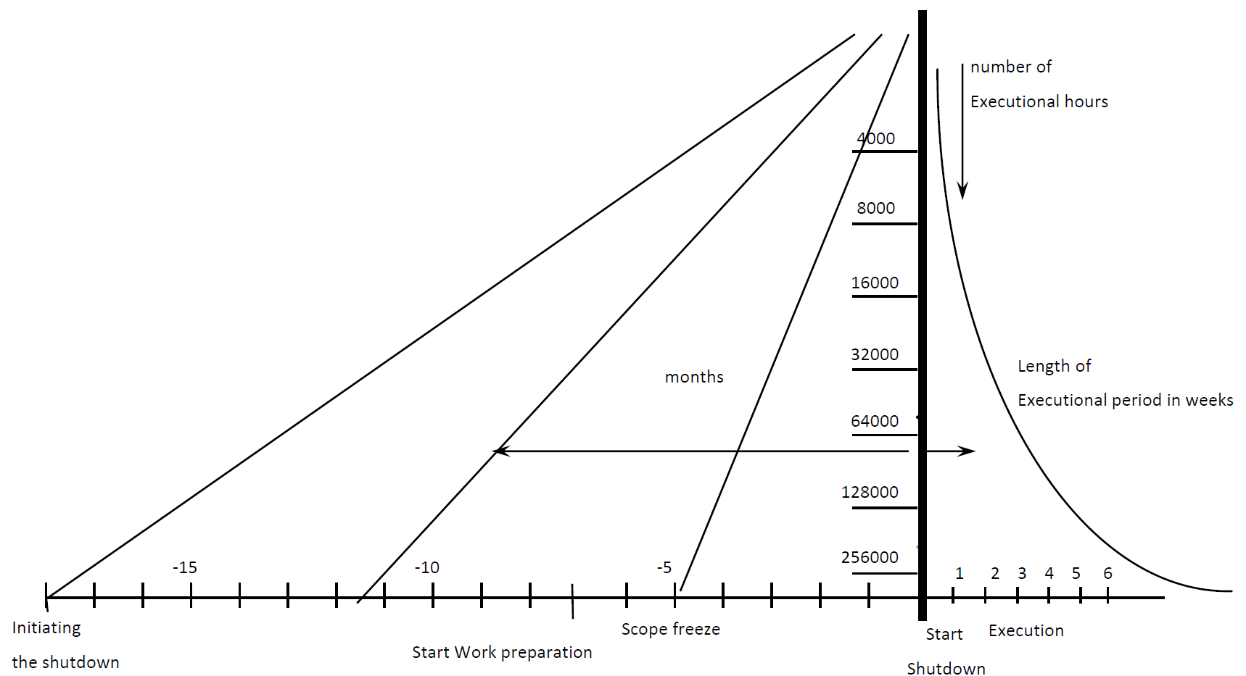
Execution hours vs. duration of execution and planning phases
www.STOcontrol.com

Slide 10

Today’s challenges

Slide 11






Why is it so challenging to manage shutdowns?
Time management & WPP
Staffing
Scope changes
Digitalization & Integration
Budgeting & Tendering
Turnaround Management
www.STOcontrol.com

Slide 12

Digital Work Pack Management

Slide 13

Work package management
Translating scope into clear work packs and tracking progress
Technical, work and administrative preparation and execution of the scope in such a way that the work described can be efficiently managed.
Taking into account:
    Activities
    Materials
    HSE
    Local circumstances (height, oxygen, etc.)
    Staffing
www.STOcontrol.com

Slide 14


Why need an integrated digital approach?
Using a dedicated digital solution
Traditional Work Package Management
One single-source of truth
Re-use information and historic work packs
All labor norms and historic data stored in a specific place ready to use
Transfer work packs to the other disciplines
Work packs in different formats and versions are stored at various locations
Data regarding labor norms and historic work packs is stored at various locations or comes from personal knowledge
Transferring work packs costs a lot of time/rework
www.STOcontrol.com

Slide 15
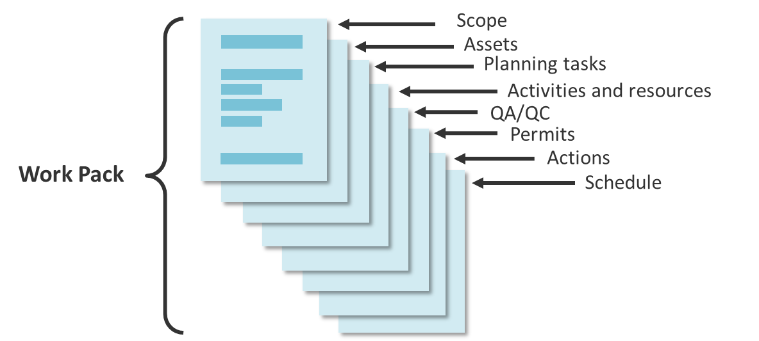
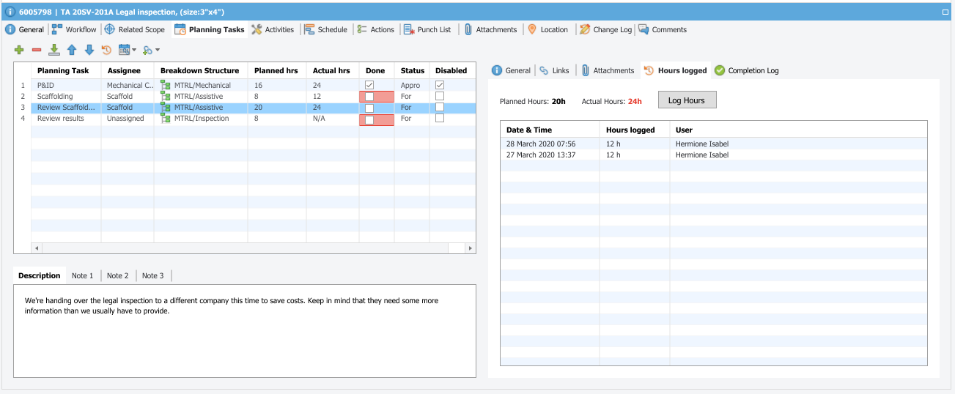
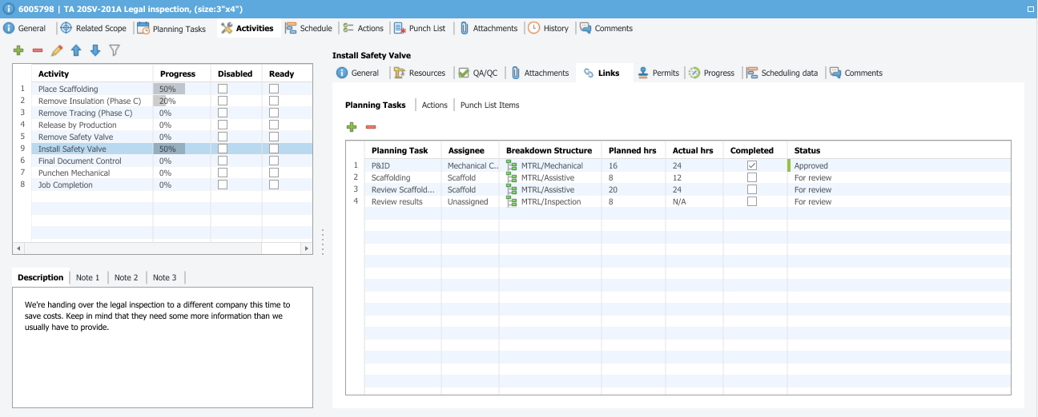
Work package preparation
Create work packs based on identified scope
Scope is translated into:
  Activities
  Materials
  Resources (Photos, 3D models, equipment drawings etc.)
  Schedule
  Permits
Assign resources to tasks and monitor the progress
www.STOcontrol.com

Slide 16
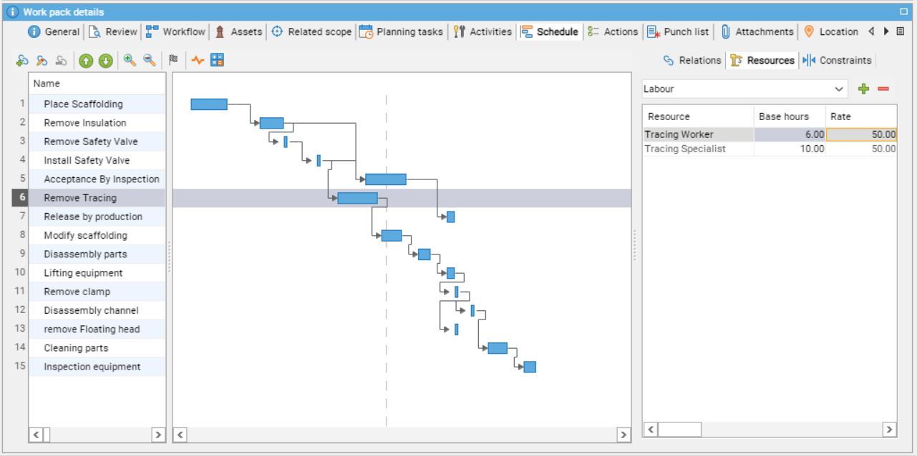

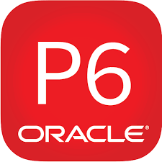
Detail planning and scheduling
Once work packs are reviewed and approved, the scheduler will start working on a more detailed schedule
The estimated work is exported to Primavera P6, to prepare the Execution Schedule
Exchange planned, actual and baseline start / finish dates to prepare resource plans
Work packs ready for scheduling
Work packs still being planned
www.STOcontrol.com

Slide 17

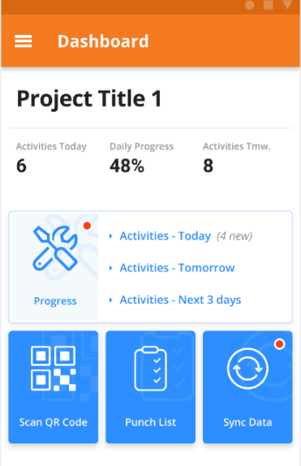
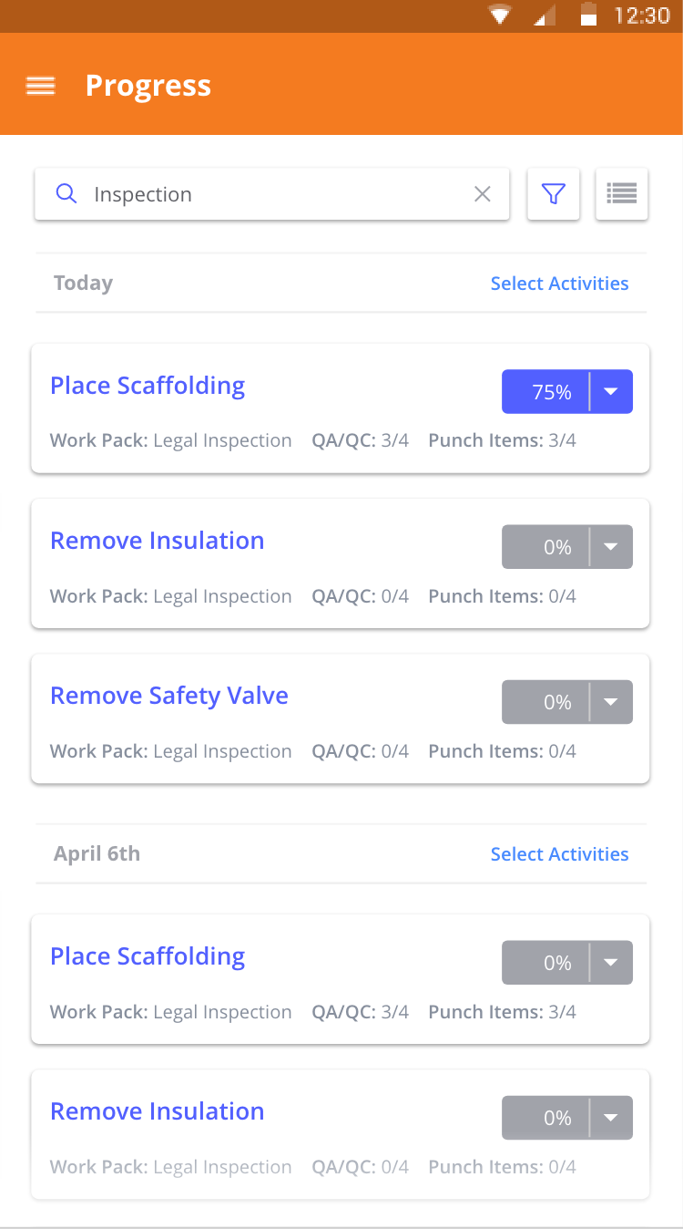
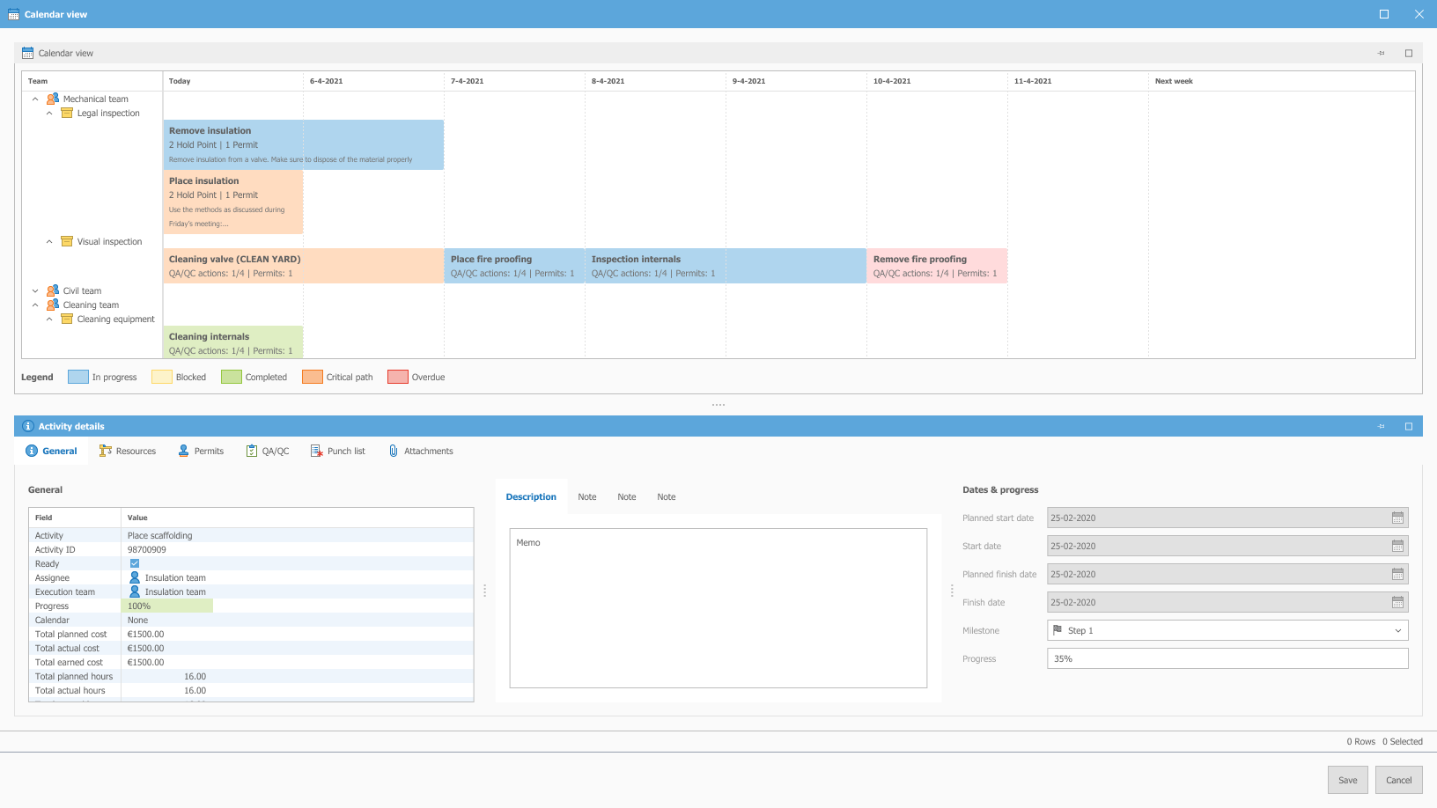

Execution
Use the power of a digital system during execution
Calendar view: what activities are next?
QA/QC dashboards
Mobile applications
www.STOcontrol.com

Slide 18
Re-use of information
Store all information in the system for later re-use
Capture work packs executed
Store updated information of assets
Include actual performance
www.STOcontrol.com

Slide 19

Summary & Conclusion
www.STOcontrol.com

Slide 20

The way forward
Use an advanced tool - one single source of truth
Store all labor norms and historic data in a centralized database ready to use
Integrate with other project control tools like ERP systems and scheduling software
Re-use historic information and standardize repetitive work packs
Visualize all data in management dashboards
www.STOcontrol.com

Slide 21

Summary & Conclusion
Achieve scope clarity, monitor scope changes, and identify scope risks
Create work packages using a centralized database and templates
Manage work packages during the turnaround execution with information from the field
Integrate work package management with project controls tools
1
2
3
4
Quality
Time saving
Standardization
Manpower
www.STOcontrol.com

Slide 22

Q & A
DO YOU WANT TO KNOW MORE?
Visit the Cleopatra booth
Schedule a demo on www.STOcontrol .com

