Slide 1


INTEGRATED PROJECT CONTROLS:
Get off your islands!
Workshop

Slide 2

About Elmer Sachteleben
Position
Experience
Senior Cost Engineer (CCE) at Cost Engineering Consultancy
Director of Cost Engineering Academy
Teacher at the Dutch Association of Cost Engineers (DACE)
Teacher at Delft University of Technology
Provided consulting services in process assessment, development, and implementation to major multinational companies such as: Shell, Unilever, Bayer, Cargill, Heineken, Fluor, Vopak, Enbridge, Yara and Rijkswaterstaat

Slide 3
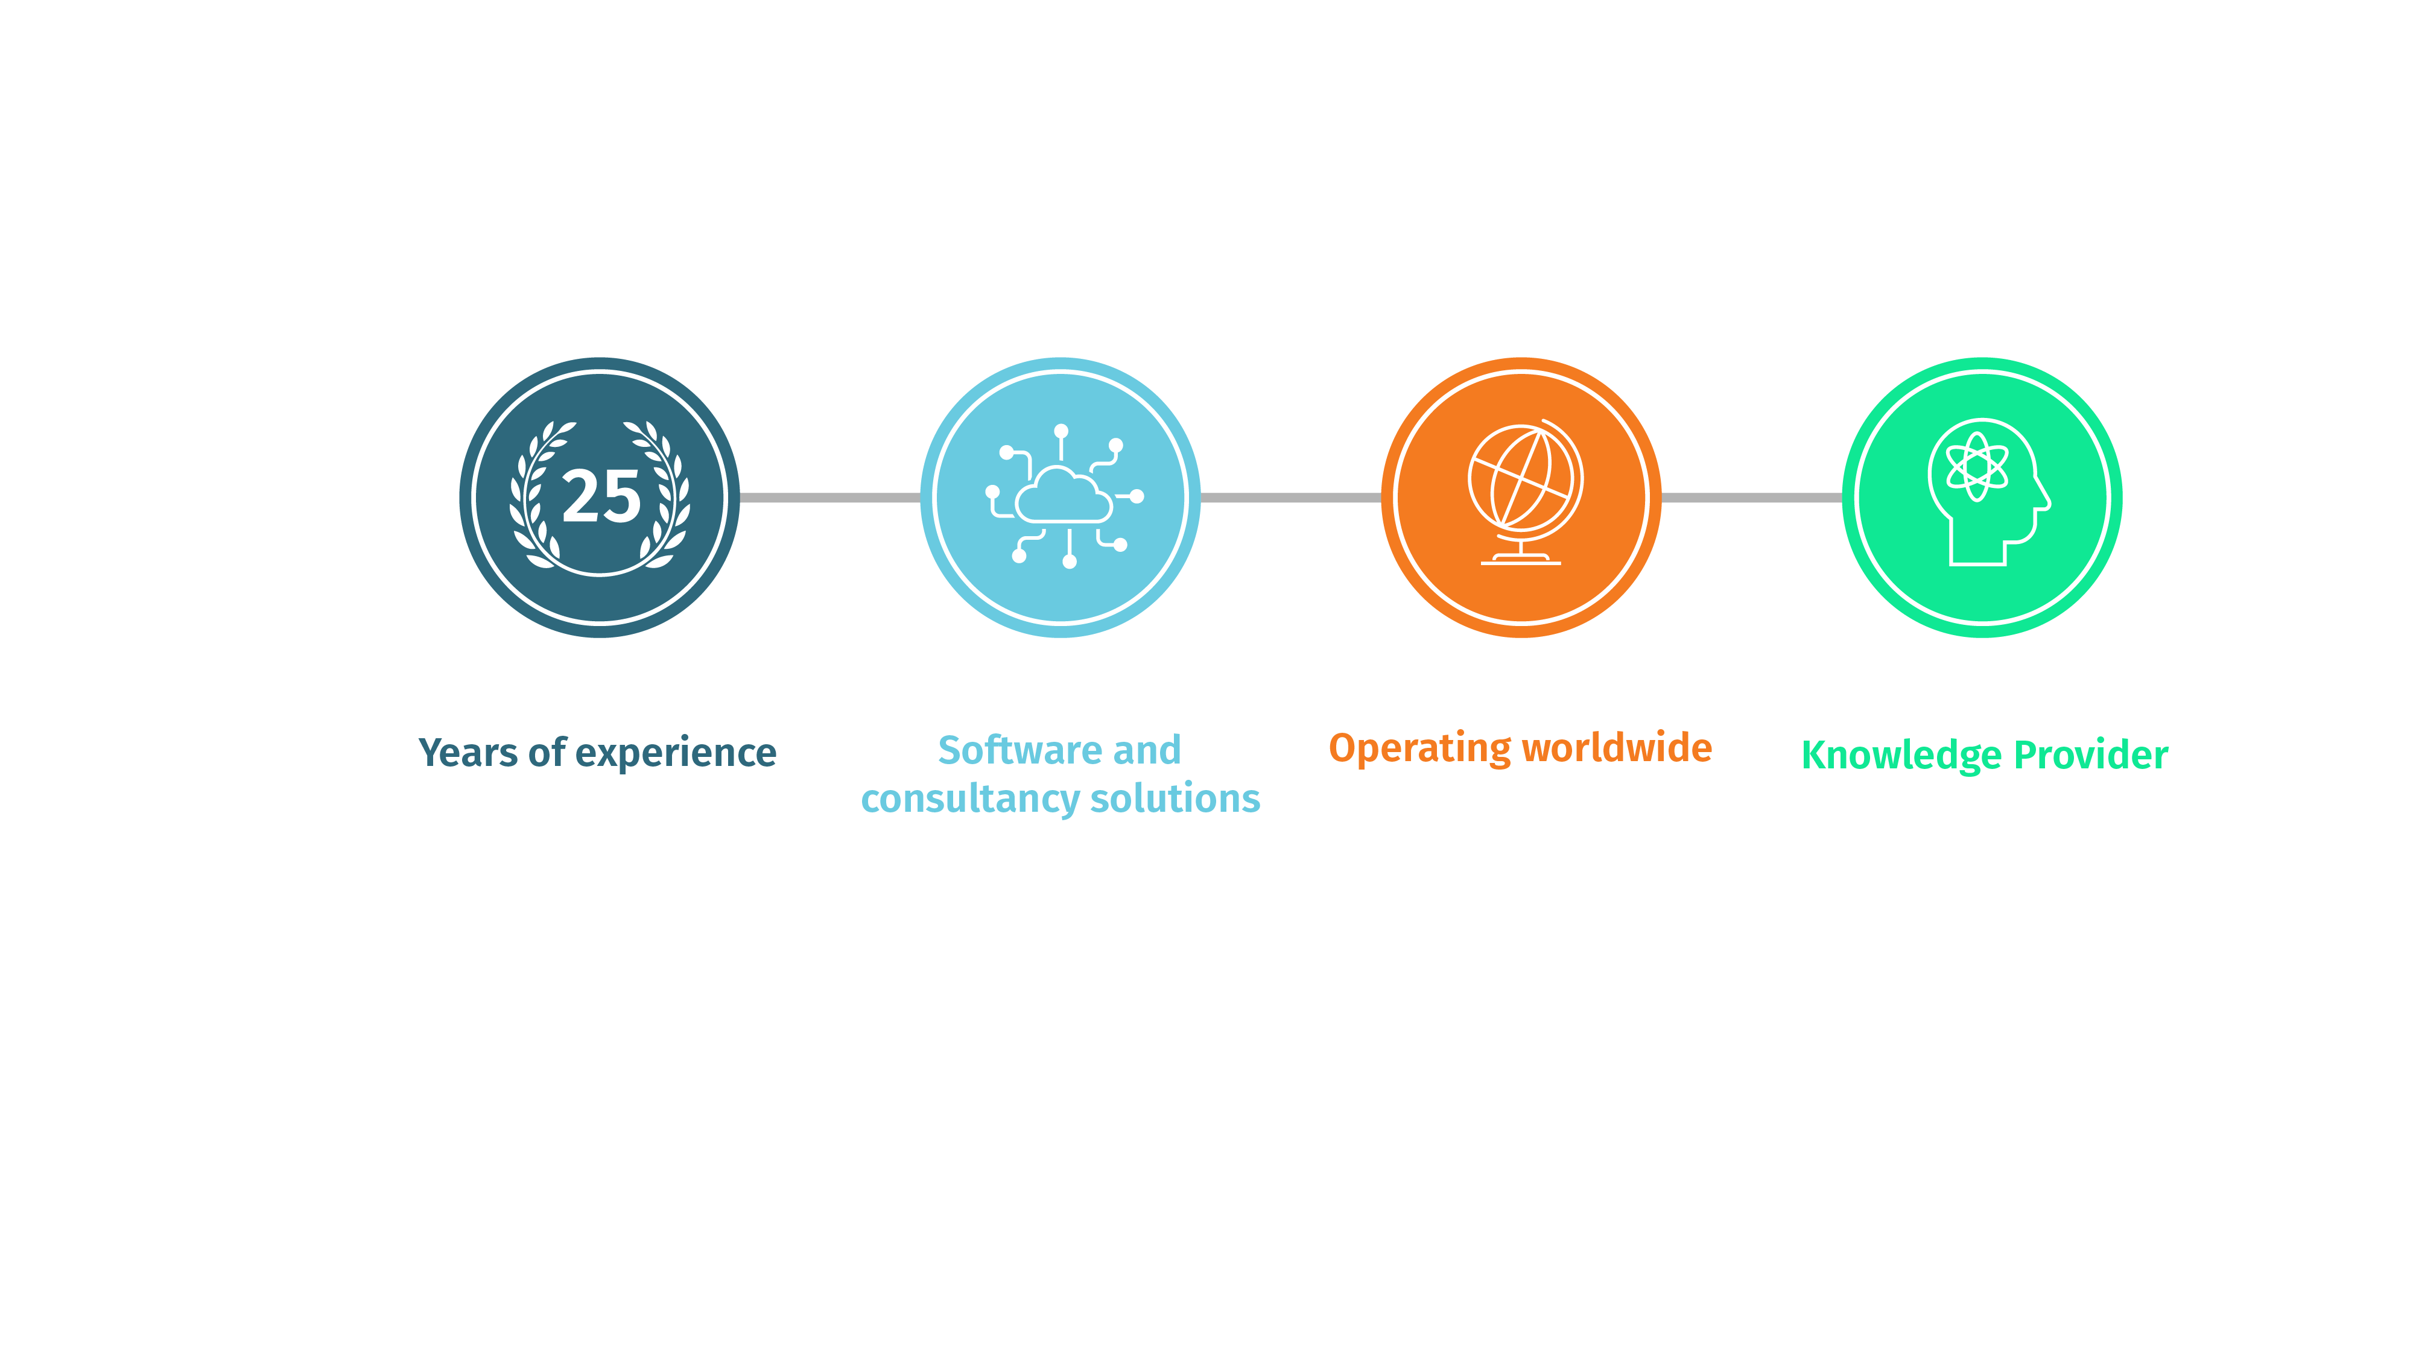

About Cost Engineering Consultancy
Empowering organizations to improve their project performance
Notes:
Note for Sales: Alternative slide to the timeline slides.

Slide 4

What we do best:
Scoping & estimating
Data analytics
WORK PACK MANAGEMENT
I
N
T
C
C
E
E
P
J
T
O
I
R
O
P
N
cost management
BIM
P
N
R
O
O
I
J
T
E
U
C
C
T
E
X
E
Execution management
SCHEDULING
TENDERING & contracting

Slide 5
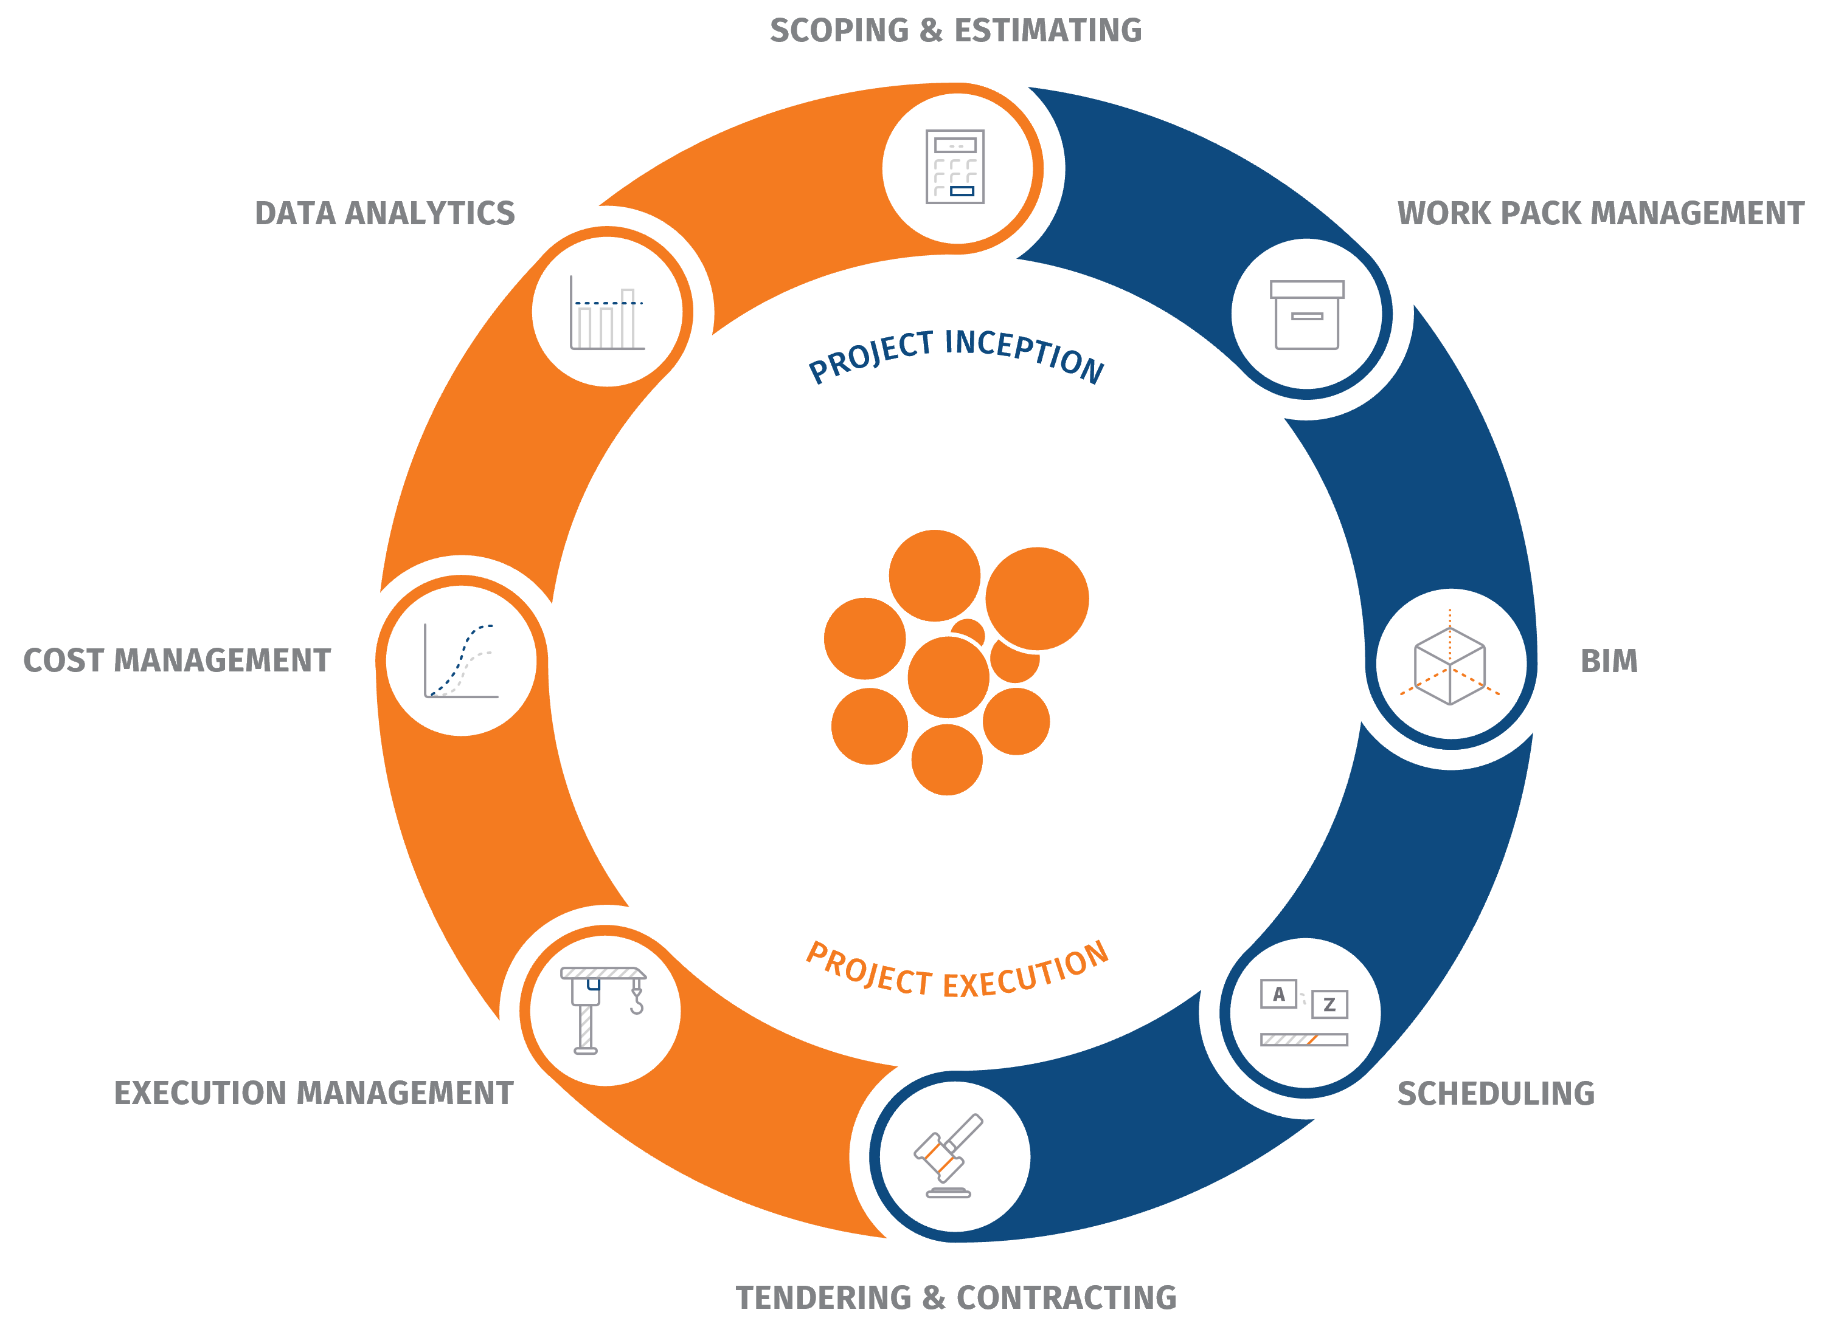
What we do best:

Slide 6




What we do best:
Consultancy
Academy
Cleopatra Enterprise
CESK Data

Slide 7



















Services Since 1996
Bulk storage
Construction industry
EPC(M)
Food and Nutrition
Infrastructure
Offshore
Oil & Gas industry
Heavy industry
Pharmaceutical industry
Petro-/chemical industry
Power industry
Mining & Minerals
Notes:
This is just a grasp of the clients we are serving. We serve a wide variety of industries and we have been doing this since 1996. We basically state that we can support any industry that performs complex technical projects. These include Oil&Gas, pharma, mining, energy, Offshore & Marine and infrastructure.

Slide 8
Topics
How are we controlling projects?
Root causes of overruns and delays
Designing an Integrated Project Controls Process
Bottlenecks
Closing the loop: project benchmarking
Case study

Slide 9

Objectives
Why is it important to see project controls as an integrated approach, instead of a collection of individual disciplines?
What are the most common pitfalls? How to avoid them?
How can your organization achieve an integrated project controls process?
How to improve investment decisions & strategies?

Slide 10
How are we doing at controlling projects?

Slide 11
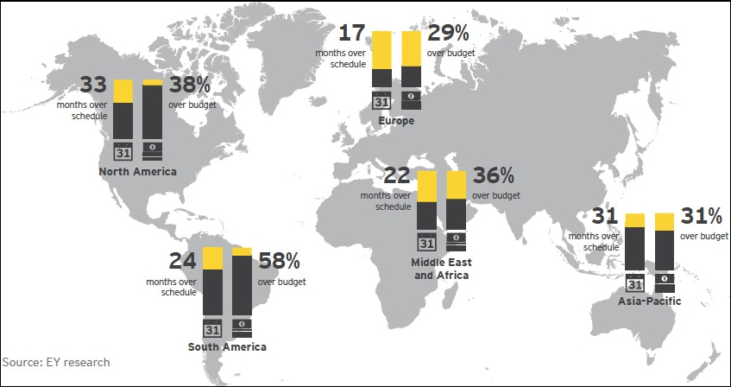
Global investement in energy transition
Source: Ernst & Young, 2016
Spotlight on power and utility megaprojects – formulas for success
Notes:
● Renewable energy: wind (on- and offshore), solar (large- and
small-scale), biofuels, biomass & waste, marine, geothermal and
small hydro
● Energy storage: stationary storage projects (large- and smallscale), excluding pumped hydro, compressed air and hydrogen. The
majority are battery projects.
● Electrified transport: sales of electric cars, commercial vehicles
and buses, as well as home and public charging investments
● Electrified heat: residential heat pump investments
● Nuclear power: reactors under construction and major
refurbishments
● Hydrogen: hydrogen electrolyzer projects, fuel cell vehicles and
hydrogen refuelling infrastructure
● Carbon capture and storage (CCS): large- and small-scale
commercial CCS projects, dedicated transport and storage
● Sustainable materials: circular economy (recycling) and bioplastics

Slide 12
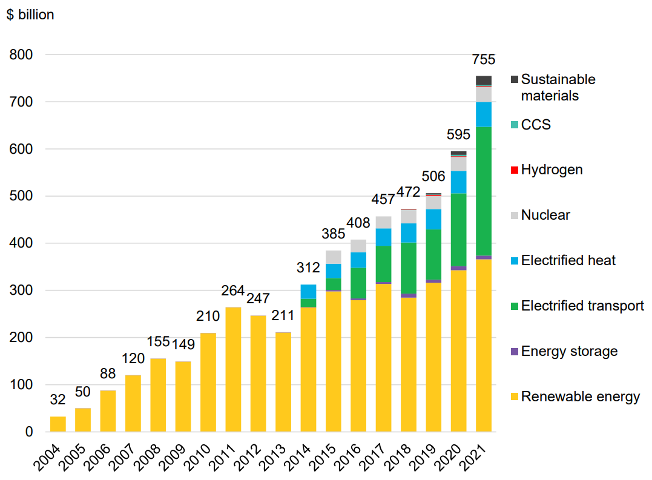
Global investement in energy transition
Source: BloombergNEF (2022)
2022 Energy Transition Investment Trends report
Notes:
● Renewable energy: wind (on- and offshore), solar (large- and
small-scale), biofuels, biomass & waste, marine, geothermal and
small hydro
● Energy storage: stationary storage projects (large- and smallscale), excluding pumped hydro, compressed air and hydrogen. The
majority are battery projects.
● Electrified transport: sales of electric cars, commercial vehicles
and buses, as well as home and public charging investments
● Electrified heat: residential heat pump investments
● Nuclear power: reactors under construction and major
refurbishments
● Hydrogen: hydrogen electrolyzer projects, fuel cell vehicles and
hydrogen refuelling infrastructure
● Carbon capture and storage (CCS): large- and small-scale
commercial CCS projects, dedicated transport and storage
● Sustainable materials: circular economy (recycling) and bioplastics

Slide 13

Global investement in energy transition
Energy project budget overruns and schedule delays cannot continue in the face of
climate change
Notes:
As said, we cover the full cycle needed to execute projects within time and budget. Cleopatra is at the heart of that. All projects are stored in a central database enabling you to have fully integrated process. Reuse of existing information is essential to become more efficient, accurate and to establish a continuous improvement process.

Slide 14
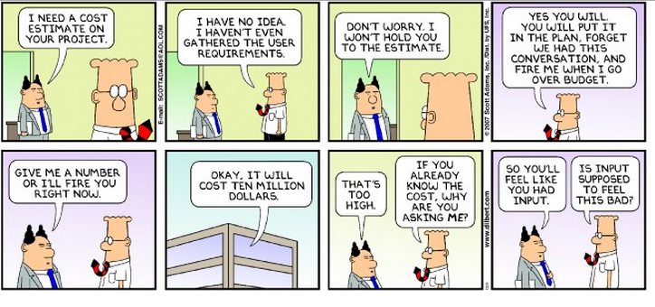
Project Controls in real life
Notes:
As said, we cover the full cycle needed to execute projects within time and budget. Cleopatra is at the heart of that. All projects are stored in a central database enabling you to have fully integrated process. Reuse of existing information is essential to become more efficient, accurate and to establish a continuous improvement process.

Slide 15
Root Causes of Overruns and Delays

Slide 16
Root causes of overruns and delays
Inadequate Communication and
Slow Decision Making
Ambiguous
Contract Terms and
Lack of Incentives
to Control Costs
Poor Risk Identification, Management and Response Strategy
Insufficient Planning and Inaccurate Estimating
Poor Project Controls
(Cost & Schedule)
Misalignment of departments and software systems
Design Errors
and Omissions
Leading to Scope Growth and/or Rework
Ineffective Project Governance, Management and Oversight
Late Design/Poor Project Definition
Notes:
As said, we cover the full cycle needed to execute projects within time and budget. Cleopatra is at the heart of that. All projects are stored in a central database enabling you to have fully integrated process. Reuse of existing information is essential to become more efficient, accurate and to establish a continuous improvement process.

Slide 17
Root causes of overruns and delays
Inadequate Communication and
Slow Decision Making
Ambiguous
Contract Terms and
Lack of Incentives
to Control Costs
Poor Risk Identification, Management and Response Strategy
Insufficient Planning and Inaccurate Estimating
Poor Project Controls
(Cost & Schedule)
Misalignment of departments and software systems
Design Errors
and Omissions
Leading to Scope Growth and/or Rework
Ineffective Project Governance, Management and Oversight
Late Design/Poor Project Definition
Notes:
As said, we cover the full cycle needed to execute projects within time and budget. Cleopatra is at the heart of that. All projects are stored in a central database enabling you to have fully integrated process. Reuse of existing information is essential to become more efficient, accurate and to establish a continuous improvement process.

Slide 18
Designing an
Integrated Project Controls Process

Slide 19
Continuous Improvement
PLAN
Continuous Process
Every process uses feedback and
improvement!
Integrated
Every process has P,D,C&A steps,
linked to the business strategy!
(plan activities)
ASSESS
DO
(evaluate
PDCA
measures, act
Cycle
(perform
upon variances)
activities)
CHECK
(measure
performance
of activities)

Slide 20
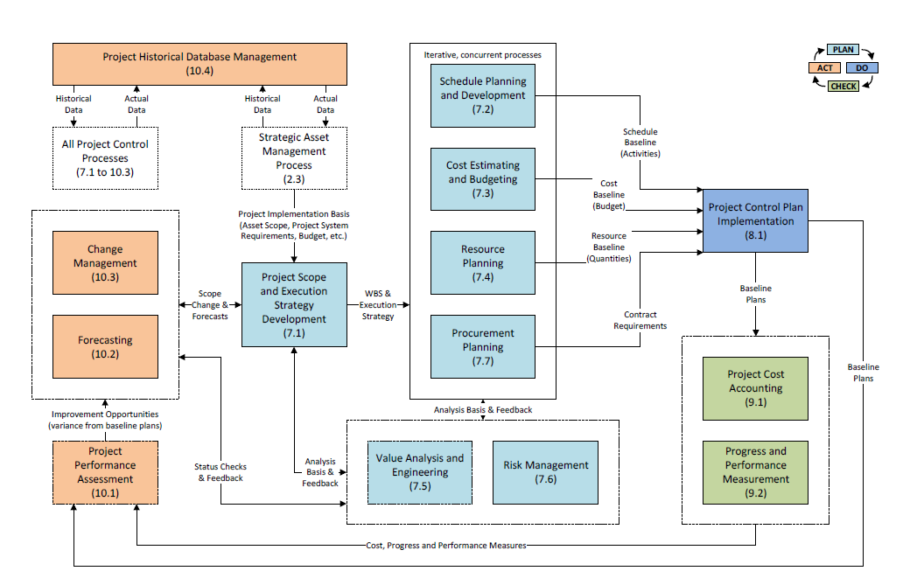
PLAN
ASSESS
PDCA
DO
Cycle
CHECK
Ref: Total Cost Management Framework, 2nd Edition, AACE International

Slide 21
Closing the loop:
Integrated Project Controls

Slide 22

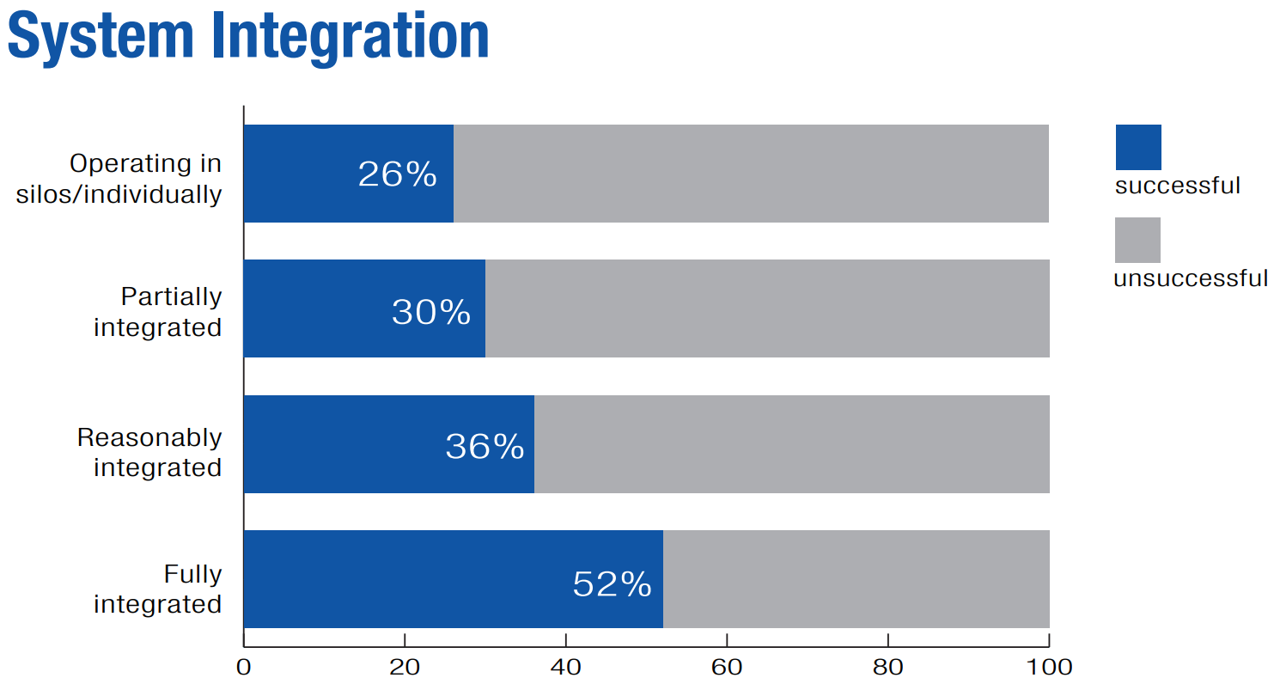
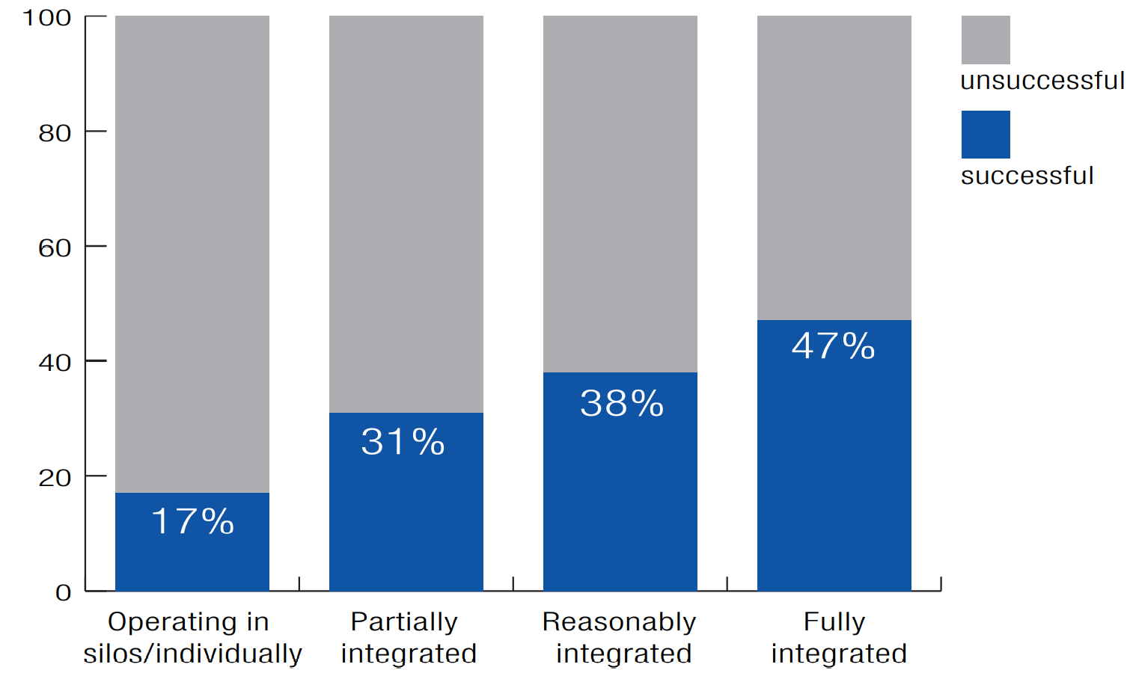
Integration leads to better project outcomes
Source: Logikal – 2020 Project Controls Survey Report
Notes:
Elmer introduces the case as being a best practice at shell.
Question
Richard, tell us about this.
Fabrication, pre-commissioning, load-out and seafastening of the Monotower Platform L13-FI-1. The design of the Monotower Platform is based on the existing L09-FA design. Produced gas will be exported by a 12” pipeline to K15-FA-1. A piggyback line will be installed for import of one production chemical (KHI). On the platform an injection skid, comprising of a storage tank and injection pumps, will be installed for injection of a second production chemical (CI)

Slide 23



Integrated Project Controls Process
Software systems support an integrated approach.
As a result, maximum project performance can be achieved
Setting up a transparent Cost Baseline which meets stakeholder requirements.
Monitoring of project costs and planning during execution
Visualize performance indicators / KPIs
Provide improved forecasting information
Perform Big Data analysis to retrieve meaningful ratios and metrics from projects to Benchmark and calibrate estimating data.
Notes:
As said, we cover the full cycle needed to execute projects within time and budget. Cleopatra is at the heart of that. All projects are stored in a central database enabling you to have fully integrated process. Reuse of existing information is essential to become more efficient, accurate and to establish a continuous improvement process.

Slide 24
Integrated Project Control Landscape
Cost Estimating &
Planning
Cost Management & Benchmarking
Knowledge bases
Benchmarking
Quotes,
Price data,
Metrics,
Cost Models
Time reporting
Baseline,
Changes,
Forecast
Equipment list,
MTO, BOQ
Engineering
Estimating
Cost Management
Actual hours
Progress
PO, Contract,
Actual costs,
Payments
Progress (Quantity surveying)
Schedules,
Work packages
Scheduling, work planning
ERP

Slide 25
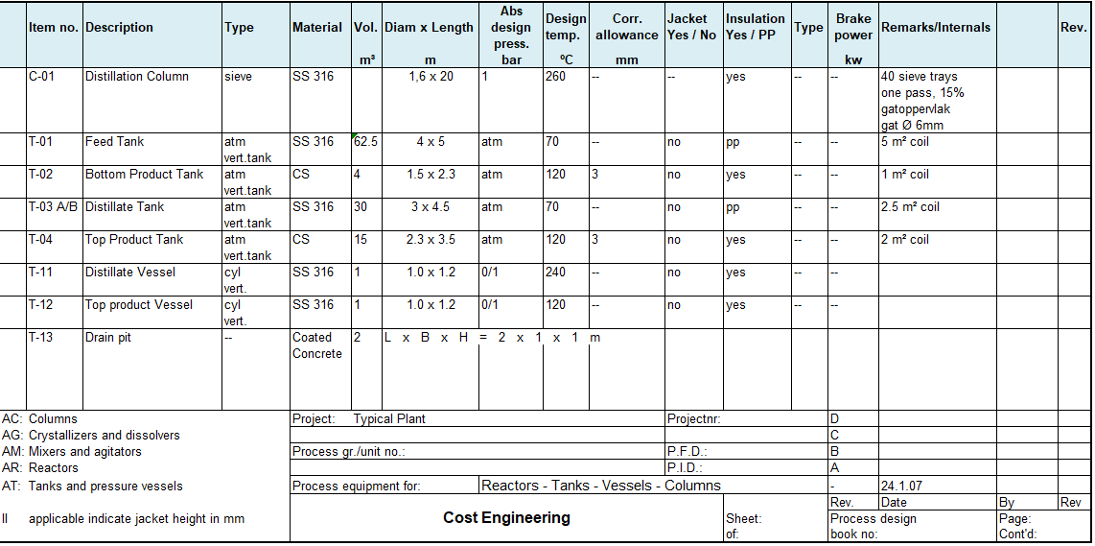
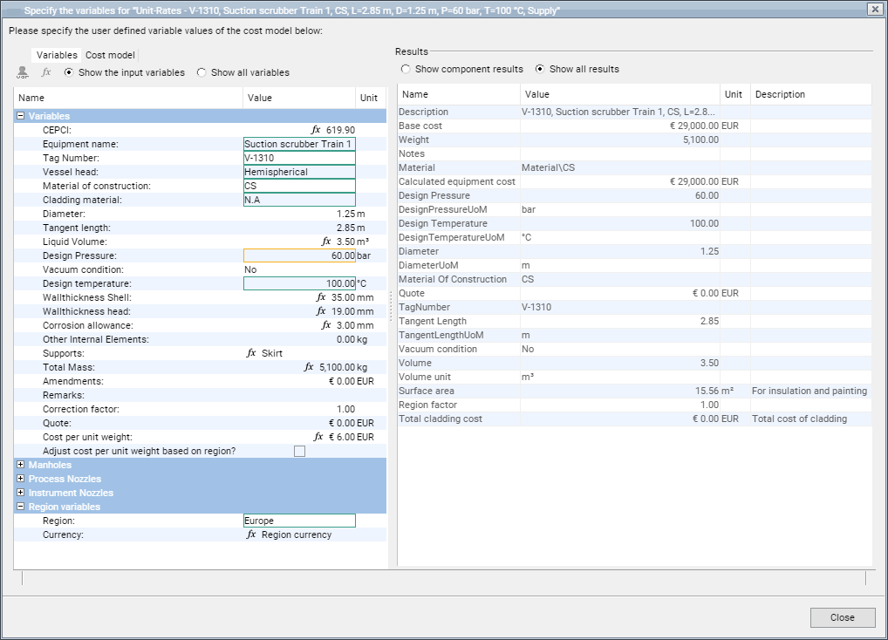
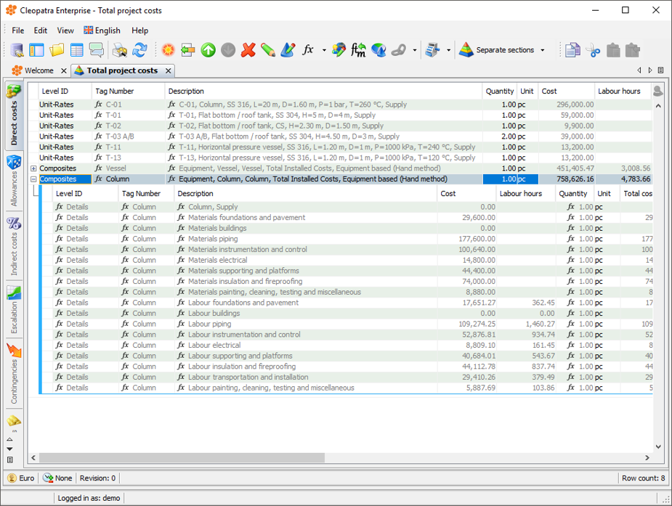
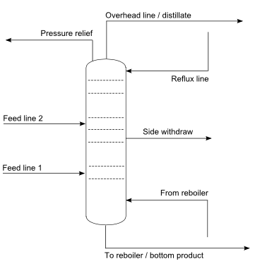
From design to estimate

Slide 26
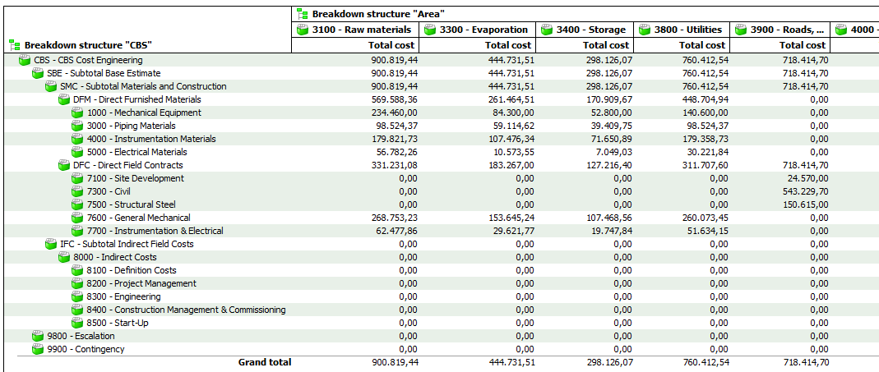
Structuring the estimate
Structured estimate report
Notes:
As said, we cover the full cycle needed to execute projects within time and budget. Cleopatra is at the heart of that. All projects are stored in a central database enabling you to have fully integrated process. Reuse of existing information is essential to become more efficient, accurate and to establish a continuous improvement process.

Slide 27
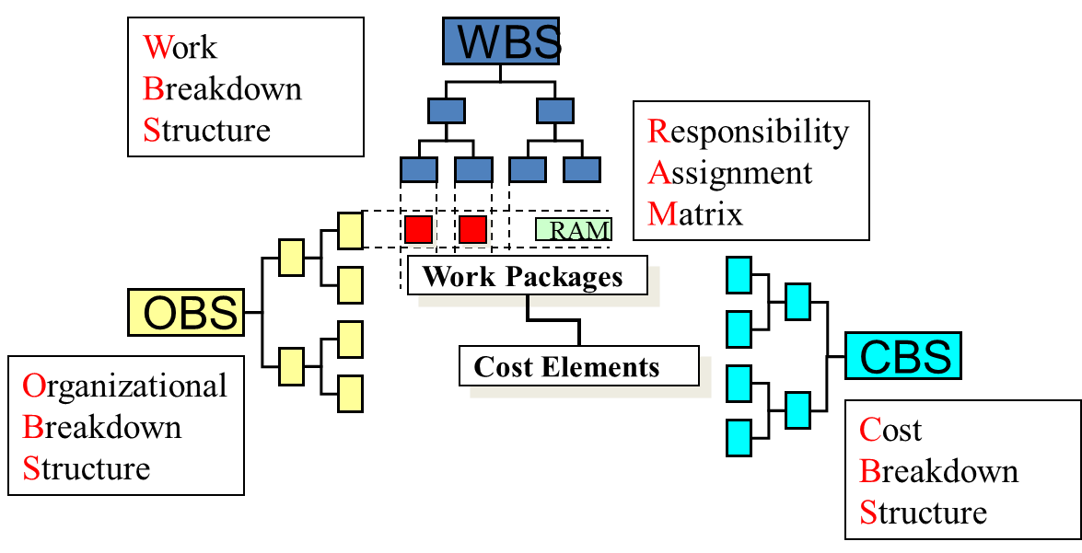
Breakdown structures
 | WBS | OBS | CBS
Install valve | Area 1, Tower T-01 | Mechanical contractor | Direct costs, piping, valves
Prefab insulation | Area 1, Vessel V-04 | Insulation contractor | Direct costs, insulation, sheeting
Remove scaffold | Area 1, Vessel V-04 | Scaffolding contractor | Indirect costs, scaffolding

Slide 28
Spend valuable time on what really matters
Forecasting & Trending
Manual Downloading
Corecting Labor Coding
Change Management
Monitoring & Controlling Costs
Fixing Cost Accounts

Slide 29
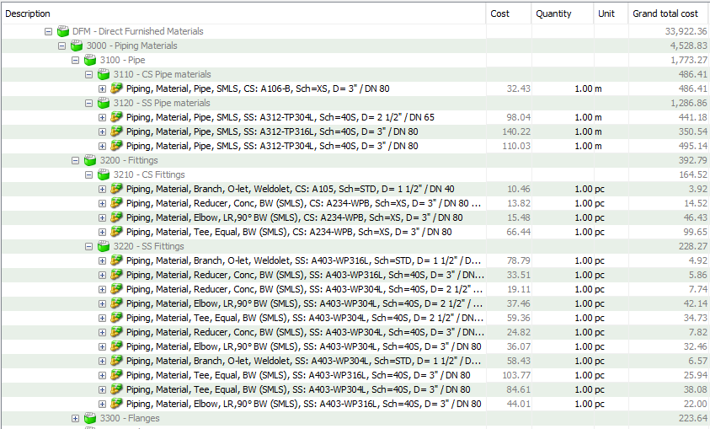
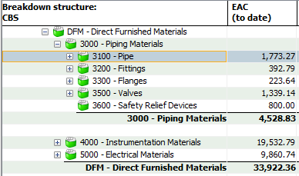
Forecast – Link with estimate
Link with cost estimate
Integrate cost control and estimating
Involvement of cost estimator in execution phase
More accurate and detailed baseline, changes and forecasts
Cost estimate
Cost report
Notes:
As said, we cover the full cycle needed to execute projects within time and budget. Cleopatra is at the heart of that. All projects are stored in a central database enabling you to have fully integrated process. Reuse of existing information is essential to become more efficient, accurate and to establish a continuous improvement process.

Slide 30
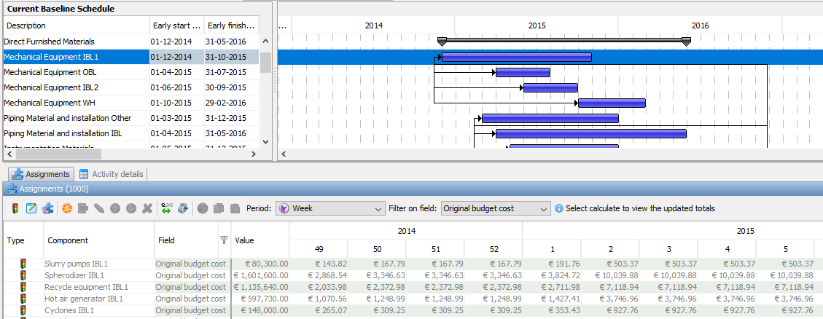
Forecast – Link with schedule
Baseline schedule
Link with schedule
Integrate schedule for time phasing cost, hours and earned value
Scheduler, cost estimator and project controller working as a team
Breakdown structures like WBS are key
Time-phased budget
Notes:
As said, we cover the full cycle needed to execute projects within time and budget. Cleopatra is at the heart of that. All projects are stored in a central database enabling you to have fully integrated process. Reuse of existing information is essential to become more efficient, accurate and to establish a continuous improvement process.

Slide 31
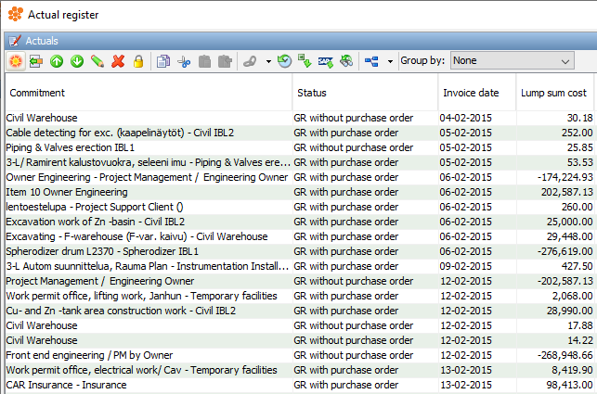
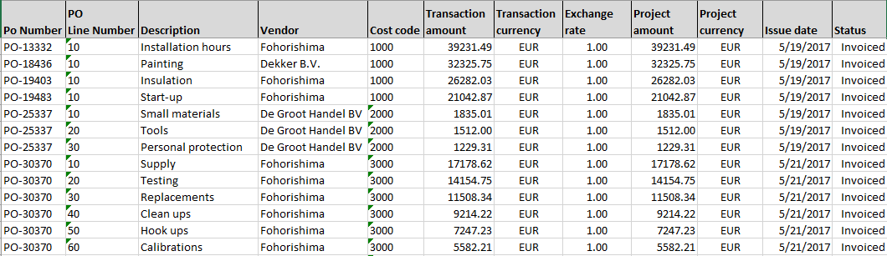
Forecast – Link with ERP system
Link with ERP
Integrate with ERP system for quick exchange of cost data
Standardize coding structures
Imported actuals
Actuals from ERP
Notes:
As said, we cover the full cycle needed to execute projects within time and budget. Cleopatra is at the heart of that. All projects are stored in a central database enabling you to have fully integrated process. Reuse of existing information is essential to become more efficient, accurate and to establish a continuous improvement process.

Slide 32
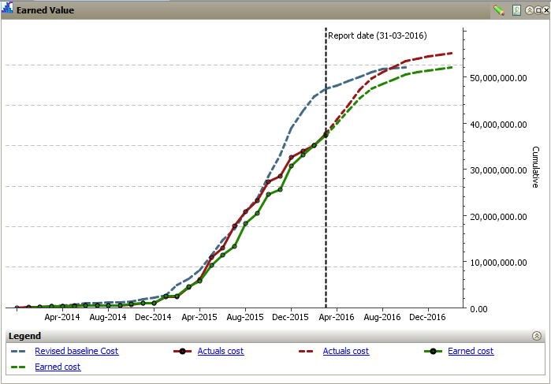
Performance monitoring
S curves
Forecast (EAC)
Baseline: planned value
Earned value
Expenditures

Slide 33
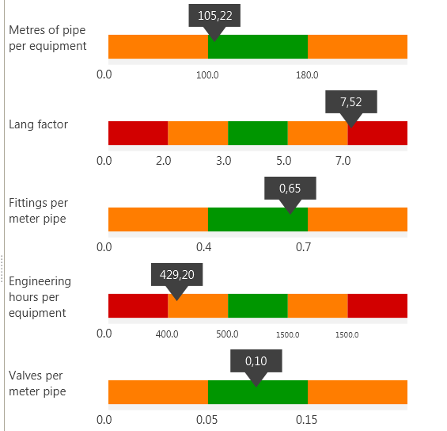
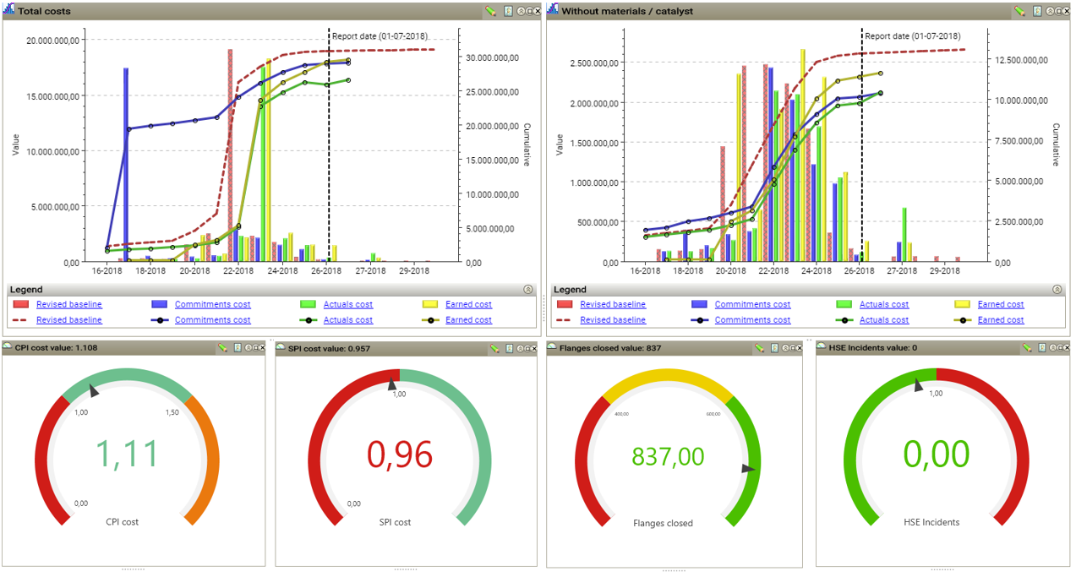
Performance monitoring
Cost Management Dashboard
1.00
1.50
1.0
CPI
SPI

Slide 34

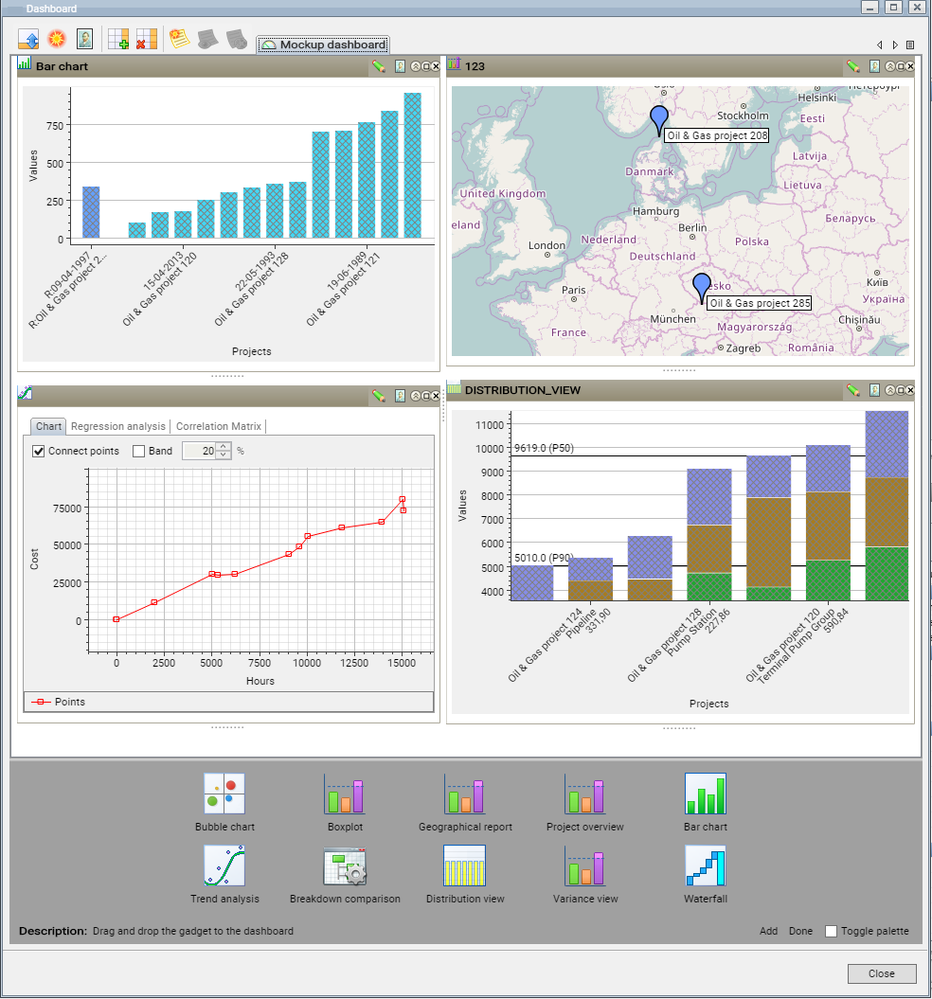
Project Benchmarking
Collect historical project data
Normalise and index
Analysis to improve accuracy
and reliability of estimating
and forecasting
Portfolio analysis on assets
Derive metrics on asset level
Notes:
As said, we cover the full cycle needed to execute projects within time and budget. Cleopatra is at the heart of that. All projects are stored in a central database enabling you to have fully integrated process. Reuse of existing information is essential to become more efficient, accurate and to establish a continuous improvement process.

Slide 35
Project continuous improvement
Notes:
Our mission is to help our clients to improve their projects performance. More specifically to help them execute projects within time and budget? Is that needed? McKinsey reports state that 60% of the Oil&Gas projects deal with overruns on cost and schedule. On average they have a 50% overrun. So it is needed.
How we do that? By making sure we cover all aspects that are involved. The foundation for a successful project is a sound estimate, delivering the budget. Once the budget is determined a schedule has to be made to determine the order of activities and the resources involved. During project execution we help to ensure that our clients stay within time and budget. On project close out all relevant data has to be captured in order to perform big data analysis to improve estimates for future projects.
This results in a continuous improvement cycle sometimes referred to as the PDCA cycle for project controls.
We cover these aspects by
Providing consultancy services. Our senior consultants provide estimating and validation services, tendering and commercial bid evaluations, they perform cost control projects or organize risk assessments workshops
We develop our own software Cleopatra Enterprise which covers all these aspects of this cycle. I will return to this later on
We have our Cost Engineering Academy which teaches in every discipline of cost engineering. We are an official AACEI approved education provide and we provide courses for cost engineers to become certified
And last but not least we provide datasets or knowledgebases how we call them which are used for better and faster estimating. I will also tell a bit more about this later on.

Slide 36
Conclusion

Slide 37
Conclusion
Still a long way to go in successfully controlling projects
Various challenges that need to be addressed:
  Disciplines treated as individual silos
  Different departments responsible for their own ‘shop’
  No ‘standardized breakdown structures’
  Recasting of estimates
  No consistent close-out at the end of projects
  The human factor
  No alignment between software tools
Notes:
As said, we cover the full cycle needed to execute projects within time and budget. Cleopatra is at the heart of that. All projects are stored in a central database enabling you to have fully integrated process. Reuse of existing information is essential to become more efficient, accurate and to establish a continuous improvement process.

Slide 38
Conclusion
Organizations should assess their IPC process
Significant improvements can be expected by increasing the level of IPC
  More accurate and reliable (early phase) estimates
  More time to focus on analysis
  Increased profitability on projects through less overruns and more efficient work processes.
  Ability to benchmark and perform big data analysis improves competitive outcomes, and provides companies in understanding their cost drivers and behaviours.
Notes:
As said, we cover the full cycle needed to execute projects within time and budget. Cleopatra is at the heart of that. All projects are stored in a central database enabling you to have fully integrated process. Reuse of existing information is essential to become more efficient, accurate and to establish a continuous improvement process.

Slide 39

The people who resist change will be confronted by the growing number of people who see that better ways are available; thanks to technology.
- Bill Gates

Slide 40
Case Study

Slide 41
Case Study
Simulation of project control for a construction project:
challenges of an integrated team
  Setting up an estimate plan and base of the estimate
  Connecting engineering design, cost and time
  Introducing structure to solve complex problems
  Sharing information and cost data between departments
  Working together as an integrated project controls team
Notes:
As said, we cover the full cycle needed to execute projects within time and budget. Cleopatra is at the heart of that. All projects are stored in a central database enabling you to have fully integrated process. Reuse of existing information is essential to become more efficient, accurate and to establish a continuous improvement process.

Slide 42
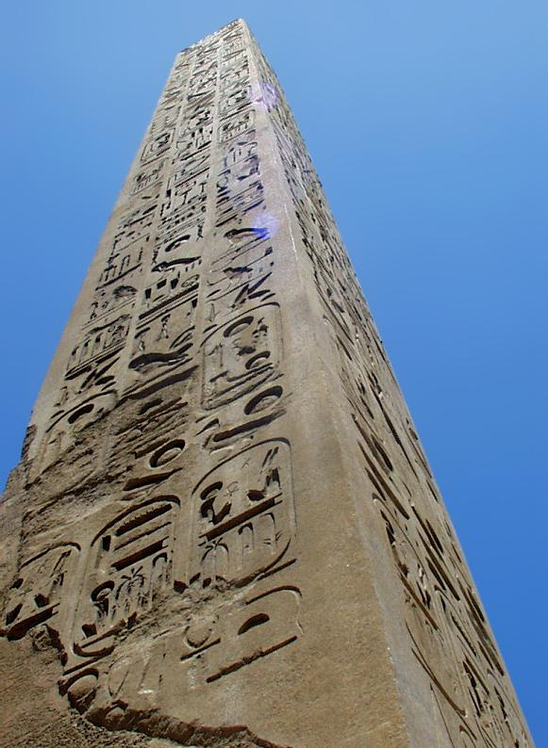
Case Study
The Obelisk of Zin
In the old city of Atlantis, a big three-dimensional square obelisk was erected. It was called ZIN, and it was built to honour the goddess Tina.
The obelisk was built within two weeks and it is your task, as a member of an archaeological expedition on the site of the old city of Atlantis, to recover the day of the week in which the obelisk was finished.
Notes:
As said, we cover the full cycle needed to execute projects within time and budget. Cleopatra is at the heart of that. All projects are stored in a central database enabling you to have fully integrated process. Reuse of existing information is essential to become more efficient, accurate and to establish a continuous improvement process.

Slide 43
Case Study
The Obelisk of Zin
Question: what is the project delivery day?
  Form groups: your project control team
  Each member gets cards, each holding a unique piece of information
  Share information without showing your cards
  Plan your problem solution and bring structure to your working method: first set up your estimate plan
  Work together as an integrated project controls team!
Notes:
As said, we cover the full cycle needed to execute projects within time and budget. Cleopatra is at the heart of that. All projects are stored in a central database enabling you to have fully integrated process. Reuse of existing information is essential to become more efficient, accurate and to establish a continuous improvement process.

Slide 44
Case Study
Solution
The Obelisk is 30x10x5m = 1500m3. The bricks are 30dm3.
Now the KEY is, that, although 1m equals 10dm, 1m3 is NOT 10dm3, but 1000dm3! So, we need 1,500,000 (dm3 for the obelisk!) divided by 30 = 50.000 bricks
How many bricks are being laid? There are 9 people present, BUT 1 OF THEM ALWAYS HAS RELIGIOUS OBLIGATIONS, so only 8 people work. The working day has 9 Schlibs, but 1 Schlib (8 Ponks), EVERYBODY rests, so they work only 7 Schlibs a day.
They lay 150 bricks ON AVERAGE, so it doesn’t matter that they get tired, that they are female, that the bricks are heavy or light, IT IS AN AVERAGE, so it ALWAYS applies. So: 7 x 8 x 150 = 8400 bricks PER DAY, so to lay 50.000 bricks, they need 5 AND A BIT working days, so they are finished on THE SECOND DAY OF THE SECOND WEEK, since on day 5 (Daydoldrum) nobody works.
The answer, therefore is NEPTIMINUS.
Notes:
As said, we cover the full cycle needed to execute projects within time and budget. Cleopatra is at the heart of that. All projects are stored in a central database enabling you to have fully integrated process. Reuse of existing information is essential to become more efficient, accurate and to establish a continuous improvement process.

Slide 45
Case Study
Evaluation
Which behaviour and which activities helped the group to reach the target?
Which behaviour and which activities blocked the group in reaching the target?
How did a form of leadership show itself in the team?
What suggestions do you have for the improvement of the team?
Do you recognise the topics from the presentation during this case?
Notes:
As said, we cover the full cycle needed to execute projects within time and budget. Cleopatra is at the heart of that. All projects are stored in a central database enabling you to have fully integrated process. Reuse of existing information is essential to become more efficient, accurate and to establish a continuous improvement process.

Slide 46

THANK YOU
For more insights, visit our websites
www.costengineeringacademy.eu
www.cleopatraenterprise.com

