Slide 1
General comment – 15/04/2022
This document is a draft version and may be subject to change. For the final document, some pictures may be added/removed and the layout will be adjusted. No major modifications in the content are expected.
Author ensures that the final document is shared with ICEC well in advance of the conference date.

Slide 2



Early Stage & Conceptual Estimating
The cost estimator's challenges with novel technology Projects In Today’s Volatile market.

Slide 3


Agenda
Introduction
Novel technology in the process industry
Challenges for the estimator
Estimate building blocks
Estimating methodologies
Estimate input requirements
Cost basis
Risks
Conclusions
Q&A

Slide 4
Speaker
Rob Haest
Cost Estimating Team Lead
for Cost Engineering Consultancy & Cleopatra Enterprise
Certified Cost Engineer – DACE
Has provided estimating services for CAPEX & maintenance projects for several multinational companies in the traditional process industry.
Besides, an increasing number of clients served are “spin-offs” that are commercializing their novel technologies.

Slide 5





About Cost Engineering Consultancy
For 25 years, empowering organizations
to improve their project and TA performance
Cleopatra Enterprise
Cost Database (CESK)
Consultancy Services
Cost Engineering Academy

Slide 6
























Some of our clients
Bulk storage
Construction industry
EPC(M)
Food and Nutrition
Infrastructure
Offshore
Oil & Gas industry
Heavy industry
Pharmaceutical industry
Petro-/chemical industry
Power industry
Mining & Minerals

Slide 7
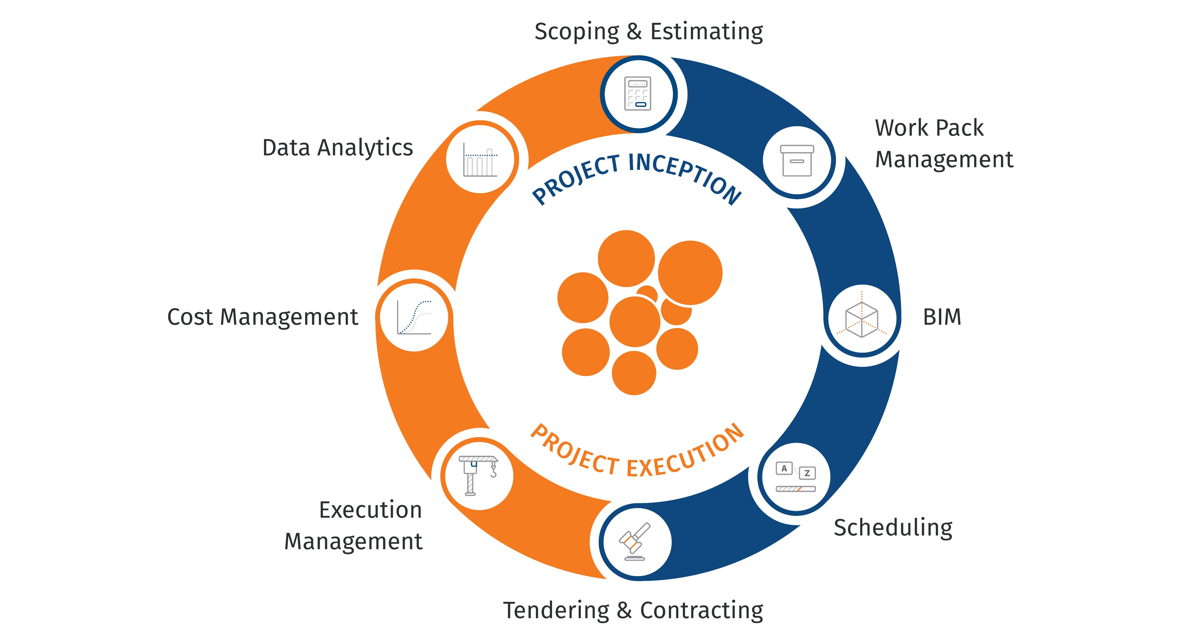
Our vision

Slide 8
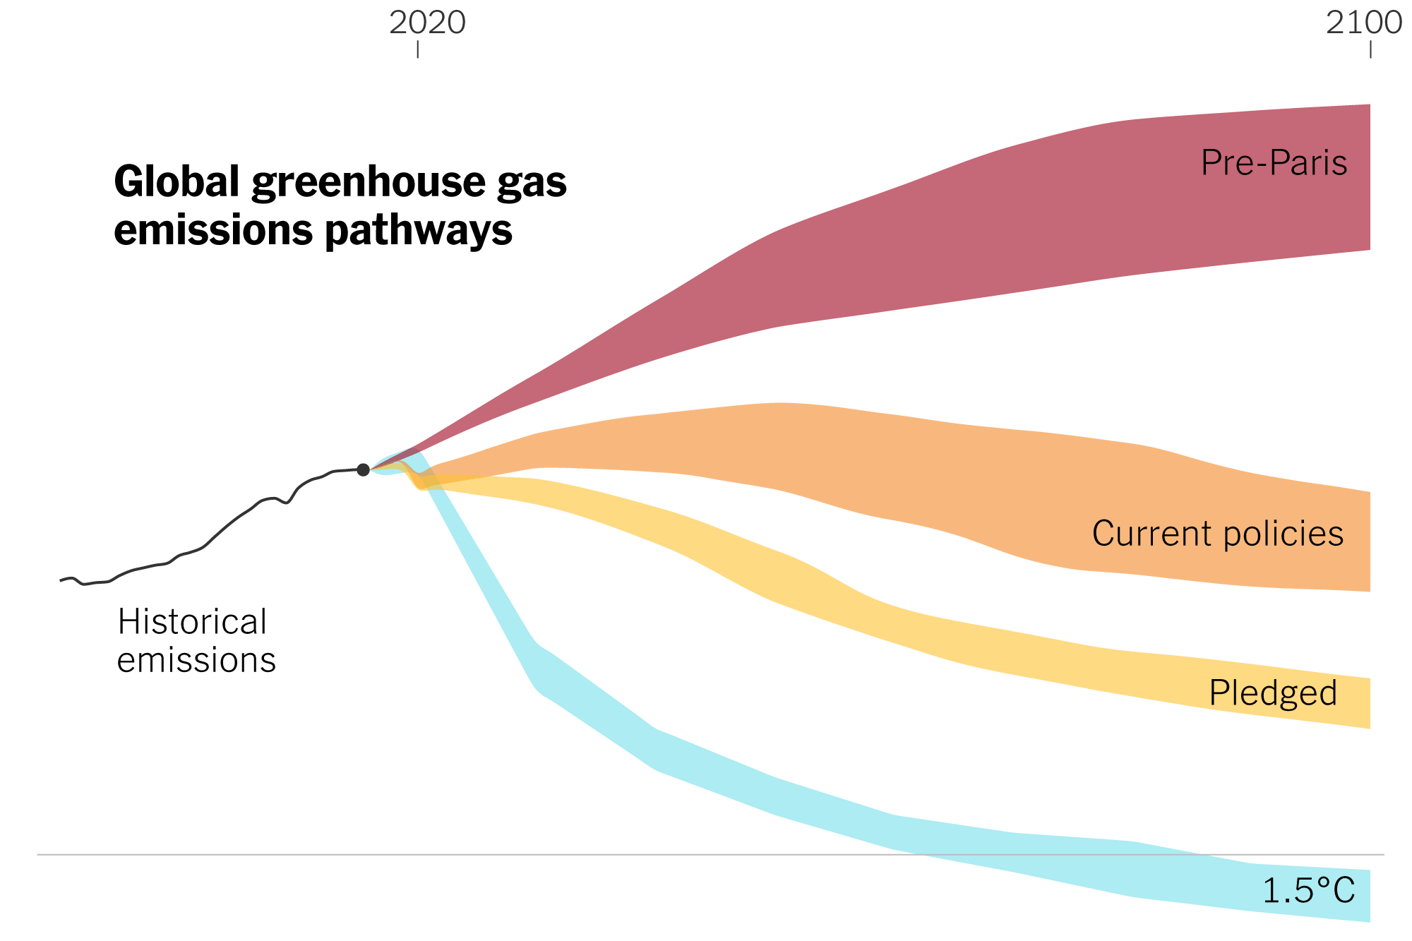
Introduction
The Paris agreement to limit the warming of the globe is the catalyst for the Energy Transition.
Novel technologies are under development to reduce the use of fossil fuel with its high CO₂ footprint.
Developments in the process industry focus on reducing energy consumption, process electrification and CO₂ capture/reuse/storage.
Source: New York Times

Slide 9
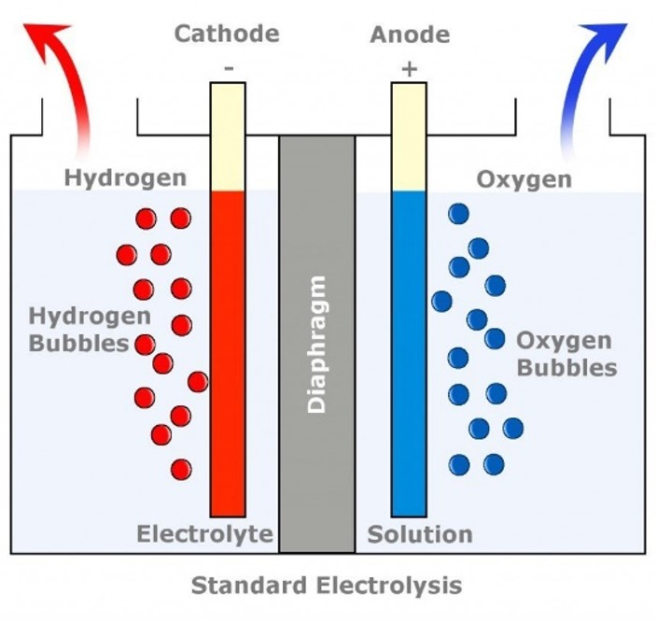
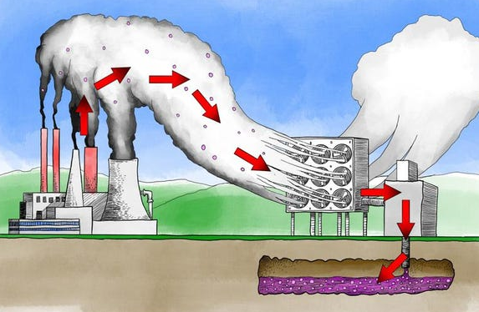

Novel technology in the process industry
There are many initiatives in the Netherlands that seek application of these new technologies. Examples are:
  Large-scale green hydrogen production
  Carbon capture technologies
  Biofuel, Synthetic fuel and other alternative fuels production
  And more..
Sources:
Researchgate.net
Forbes
Burtproces.com

Slide 10
Novel technology in the process industry
A number of technologies have already been designed, build and tested on laboratory and pilot plant scales. Proven solutions are now being commercialized on an industrial scale.
Companies, governments and other institutes are at risk of making the wrong choices. Investing in non-viable projects at the expense of more promising prospects.
Therefore, reliable early phase cost estimates are a prerequisite for securing investments in the right projects.

Slide 11
Challenges for the estimator
A reference framework for projects involving novel technology is missing for the estimator.
Besides technical challenges, cost predictability is currently being affected by a volatile market situation.
Even typical/standard investment projects in the process industry are more difficult to predict nowadays, compared to the relatively stable market situation in the past decades.
This presentation will focus on estimate methodologies to deal with 1.) technical and 2.) market uncertainties.

Slide 12
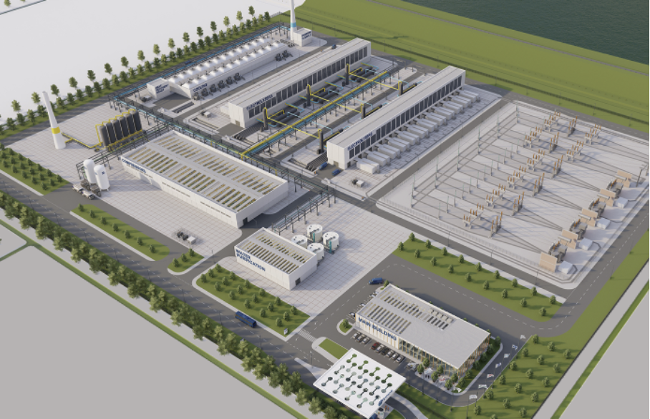
Example project
Large-scale water electrolysis for green hydrogen production.
Source: ISPT - 1GW Green-Hydrogen Plant Study 2022
Retrieved from the public domain.

Slide 13
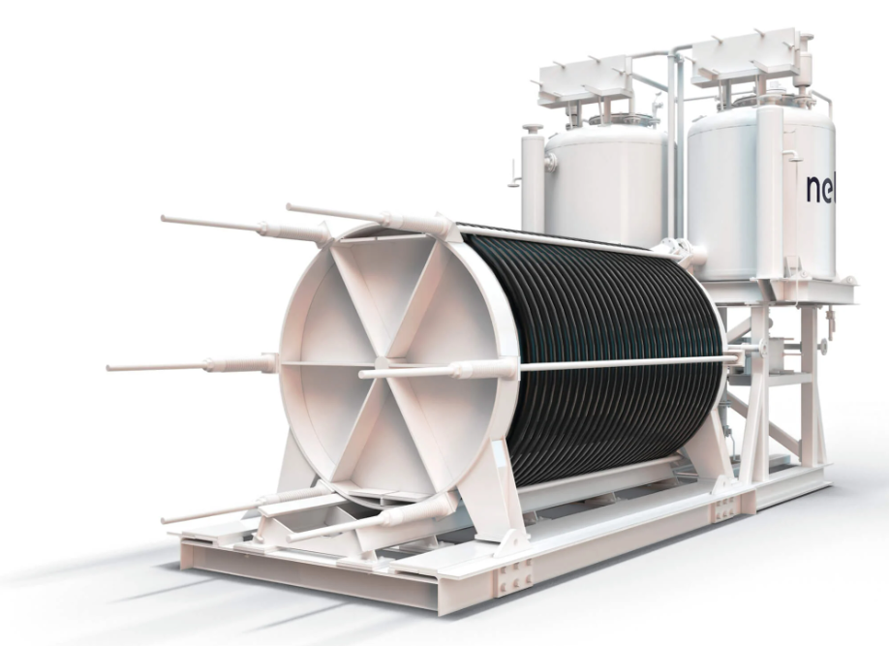
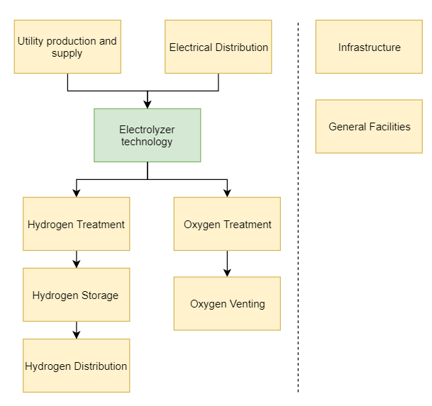
Electrolyzer stack + separator vessels
Source: NEL
Example project
Large-scale water electrolysis for green hydrogen production.
abc.
A distinction can be made between Core Technology and Balance of Plant.
Roughly 60-80% of the facilities’ technology and infrastructure has been seen before by the estimator in other projects.
The Core Technology’s technical details and cost buildup are often unknown to the estimator.

Slide 14
Estimate building blocks
Core Technology
Reference framework for the estimator is missing. Technology and specs owned by others:
  Licensor scope
  Patented technology
  Intellectual proprietary equipment
  Etc.
  Examples: electrolyzers, direct air capture filters, carbon capture technology units, etc.
Balance of Plant
Recognizable and known scope for the estimator.
  Traditional process equipment
  Bulk materials
  Construction
  Indirect costs
  Escalation, Contingency and Markups
  Owner’s Costs
  Examples: Denim water plant, wastewater facilities, fire fighting, other utility systems for steam, air, nitrogen, etc.

Slide 15
Estimating methodologies
Conceptual, Deterministic and Hybrid methods.
There are commonly two broad categories: conceptual (Stochastic or Factored) and deterministic (Detailed).
Conceptual methodologies:
  Analogy
  Capacity Factored
  Equipment Factored
  Parametric Models
Hybrid methods
  Mix of factor/parametric and deterministic methods.
Source: AACE International

Slide 16
Estimating methodologies for novel technology projects
Methodology | Core Technology | Balance of Plant | Remark
Analogy Capacity Factored | X | ✓ | Total plant or process unit costs derived from historical project costs using scaling.
Equipment Factored | ? | ✓ | Total Installed Cost based on equipment supply cost multiplied with factors (e.g. Hand/Lang).
Parametric Models | ? | ✓ | Equipment or process unit costs based on regression analysis of historical project costs.
Hybrid Methods | ✓ | ✓ | Mixture of Factored, Parametric and Unit-Rate costs.
Historical (cost) data for the Core Technology’s components are missing.
A hybrid estimating methodology could be considered by isolating the Core Technology from the Balance of Plant.

Slide 17
Estimate input requirements
Core Technology
  Technology type
    e.g. PEM vs. Alkaline electrolyzer
  Capacity
    Request multiple capacities to optimize the proposed overall facility design.
  Process flow input/output pressure, temperature and flow rate
    Interconnecting piping system requirements and Balance of Plant interfaces.
  Utility consumption
    Electricity consumption drives electrical distribution system requirements
  Weight and dimensions
    Foundation requirements can be derived from equipment weight and overall dimensions.
  I/O count
    Control system requirements can be derived from I/O count.
Balance of Plant
  Sized Equipment List
  Plot plan

Slide 18
Cost basis
Core Technology
Estimators cannot rely on historical cost databases. Involvement from from vendors / technology licensors is required.
  Most accurate technical and cost basis can be obtained by collaborating with vendors/licensors although they are reluctant in sharing information.
  Budget quotes shared often provide a limited buildup of costs. Key is to understand the quote inclusions and exclusions.
  Requesting budget quotes for multiple capacities / configurations allows the estimator to develop cost trendlines.
  This input supports the project team to perform design iterations, optimizations and Value Engineering.
Balance of Plant
The estimator’s common cost databases based on historical project data.
  Factors
  Composites
  (Equipment) cost models
  Quantitative cost relations/models (i.e. “Objects)
  Equipment vendor quotations
  Unit-rate costs
  Benchmark percentages

Slide 19
Risks
Technical
First of a Kind (FOAK) project risks should be considered in the Cost and Schedule Contingency assessment.
Interfaces between Core Technology and Balance of Plant are not fully defined. Estimator may omit or double-dip scope and costs.
Process technologists are often in the lead for contacting Core Technology vendors/licensors. Early involvement of estimators is desired in order to ask the right questions and request appropriate data.
Availability of skilled staff for Value Engineering activities in early design phases.

Slide 20
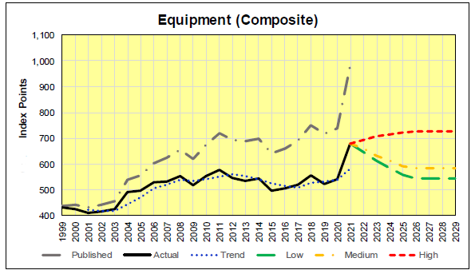
Risks
Market uncertainty
Since 2020 costs for goods have shown an increase. A sharp increase was noticed by goods with high raw material content (e.g. steel, copper). These increases are the result of high prices for raw materials, energy costs, hic-ups in the supply chain(s), geopolitical tensions, weakening of EUR compared to USD, etc.
Various sources confirm the trends although the severity deviates. The effects on short, medium and long term are difficult to assess for a project team. Corporate management should provide guidance and direction.
Cost Engineering Consultancy has created an escalation model that is using possible market scenarios Low, Medium and High. These combined with anticipated (high) inflation are the basis for the escalation calculation. For key cost categories market trends have been captured.

Slide 21
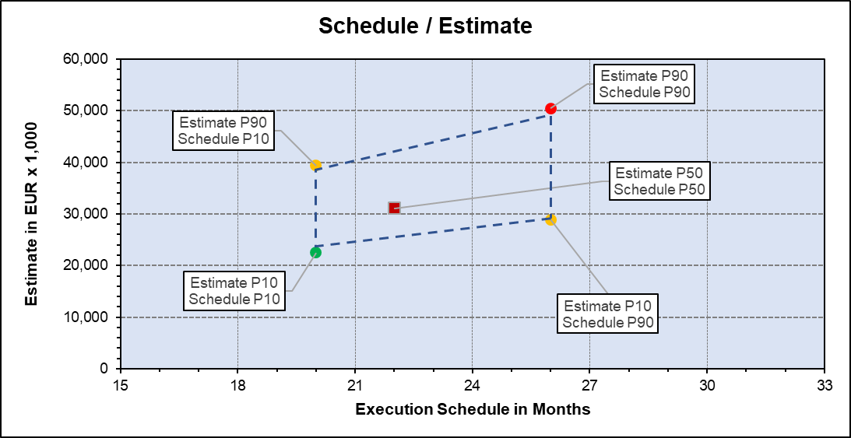
Conclusions
Having historical cost data is a requirement for most conceptual estimating methods. Isolating Core Technology components from the project and applying a hybrid method has proven to be a suitable method.
Early involvement of the cost engineer in design optimization and Value Engineering stimulates in finding the most cost effective project solutions.
Predictability of projects is heavily affected by today’s volatile market. Estimators could capture the uncertainties by considering an escalation model based on predicted market trends for key cost categories.
Task of the cost estimator to emphasize and inform stakeholders about the uncertainties and report cost and schedule ranges accordingly.

